Slide 1
Science of Flight

Slide 2
General Forces
Notes:
I’d watch until about 4:30--then it gets pretty heavily into the physics/math of thrust
Gets into a good explanation of weight

Slide 3
Thrust
Force that makes the plane go forward
Two main ways to create thrust:
Propellers
Jet engines
Which method often depends on the size and purpose of the aircraft
Notes:
Both propellers and jet engines have advantages/disadvantages. Generally, smaller aircraft that do not require a lot of speed use propellers, and larger aircraft or those that need to go faster use jet engines.

Slide 4
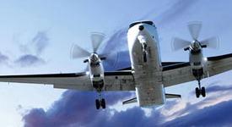
Propellers
Have slightly twisted blades to direct movement of air
Behave similarly to the wing
Larger planes require larger or more propellers
The faster a propeller spins, the more thrust it should generate
Notes:
-Twisted blades force air to move toward the back of the plane; this air pushes the plane forward
-The wings cut the air in a way that the air forced beneath the wing generates lift, the propellers do the same thing but to generate forward motion (force air in front of the blade to move over the blade faster, and air behind the blade to push the blade)
-In general, more propellers generate more thrust. This means that larger planes require more propellers
-Also in general, the faster the blades spin, the more thrust they should generate.
-Propellers require more than one blade to handle the forces generated by the engines that spin the blades. A smaller or slower engine can generally function with two blades, but a larger or faster engine requires three to four blades.

Slide 5
Jet Engines
Generally gas turbine engines (turbofans)
Like all turbines, gas turbine engines have three parts:
Compressor
Combustion Area
Turbine
Notes:
Compressor--compresses incoming air to high pressure
Combustion Area--burns fuel and uses it to heat the air, which speeds it up (high velocity, high pressure air)
Turbine--gets energy from the high pressure, high velocity air (usually a set of blades that the air pushes)

Slide 6
Turbine
Combustion Area
Compressor
Movement of Air
Notes:
In Turbofan engines you have the addition of fans at the front (before the compressor) and at the back (after the turbine) to help force air through and generate thrust for the aircraft.

Slide 7
Propulsion
Movement forward
Propulsion vs. thrust:
Thrust is the force that allows forward motion
Propulsion is the movement forward
You can’t have propulsion without thrust!
Notes:
In planes, propulsion is pneumatic or air powered.

Slide 8
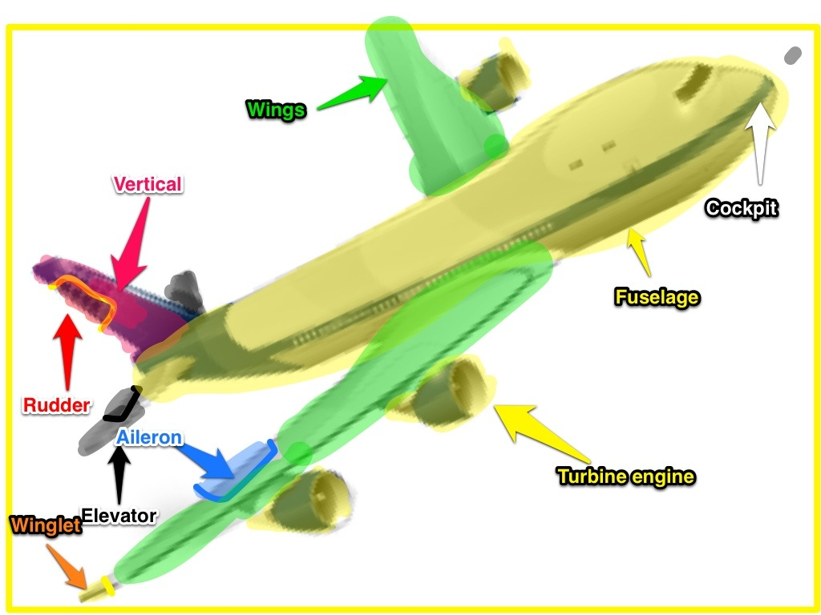
Anatomy of a Plane
Notes:
Cockpit--control center
Fuselage--main body (passenger/storage area)
Wings--generate lift
Winglet--help reduce “wingtip vortices” or the clash of air currents caused by the air above and below the wing meeting
Turbo Engines/Propellers--generate thrust
Aileron--aids in turning the plane (think paddles turning a canoe)
Vertical Stabilizer--helps stabilize plane’s course (helps combat drastic changes)
Rudder--helps control direction of aircraft (left/right)
Elevator--helps control elevation of aircraft (up/down)

Slide 9
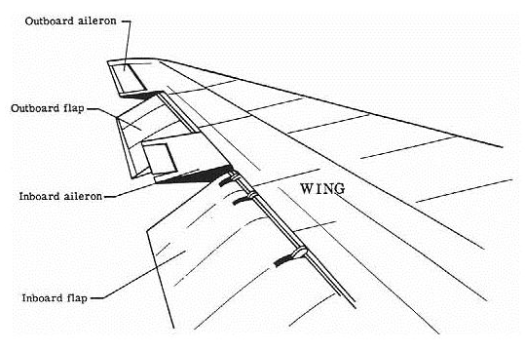
Anatomy of a Wing
Several things to consider
Wing and Airfoil Shape
Angle of Attack
Surface Area
Stability
Materials

Slide 10
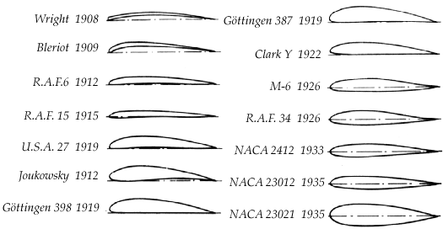
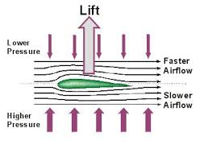
Airfoil Shape

Slide 11
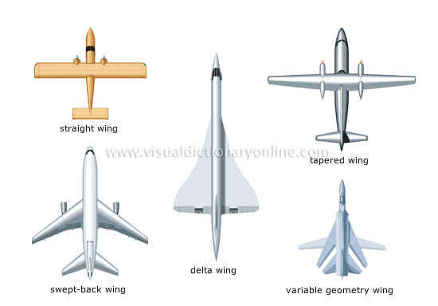
Wing Shape

Slide 12
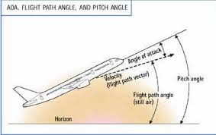
Angle of Attack
Angle of the wing
Dependent on the relative wind
Determines the amount of lift and drag as the plane moves through the air

Slide 13
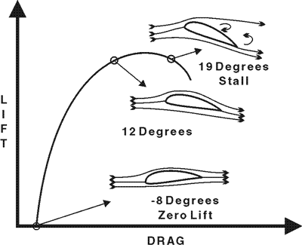
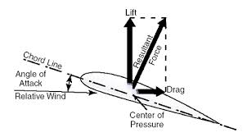
Angle of Attack

Slide 14
Internal Structure
Leading edge
Edge closest to the nose
Trailing edge
Edge closest to the tail
Wingtip
Edge farthest from the fuselage
Skin
Surface material

Slide 15
Internal Structure
Spars
From Fuselage to wingtip
Provide tensile strength
Front Spar
Center Spar
Rear Spar
Ribs
From leading edge to trailing edge
Provide airfoil shape

Slide 16
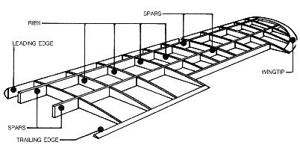
Internal Structure

Slide 17
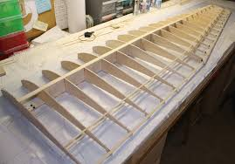
Internal Structure

