Slide 1
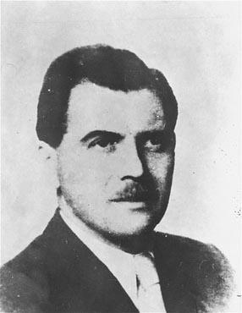
Medical Experimentation during the Holocaust
Dr. Josef Mengele, the “Angel of Death”

Slide 2
T4 Program Eugenics poster entitled "The eradication of the sick and weak in nature"
German quotation reads: "That which does not satisfy the demands of Being, collapses."
Notes:
*
Eugenics poster entitled "The eradication of the sick and weak in nature" from Hereditary Teachings and Racial Science in Pictorial Representation by Alfred Vogel
The German quotation by Dr. Grosz reads: "That which does not satisfy the demands of Being collapses." This poster is no.42 in a series entitled, "Erblehre und Rassenkunde" (Theory of Inheritance and Racial Hygiene), published by the Verlag für nationale Literatur (Publisher for National Literature), Stuttgart.
Date: 1938 Locale: Stuttgart, [Wuerttemberg] Germany Credit: USHMM, courtesy of Hans Pauli Copyright: USHMM

Slide 3
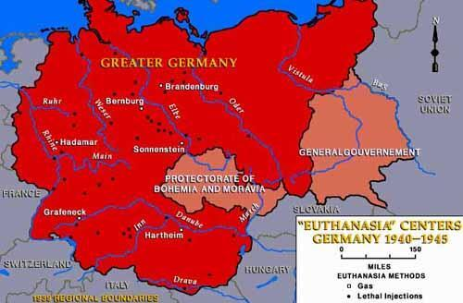
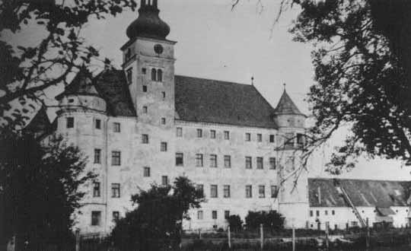
Hartheim Castle, a "euthanasia" killing center where the physically and mentally disabled were killed by gassing and lethal injection. Hartheim, Austria (USHMM Photo).

Slide 4
How could the doctors and nurses get to this point?
Nazification of Medicine
Changing of medical philosophy from healing the patient to healing the “volk”
State – endorsed programs centering around biological ideas → creating a stronger society
Use of medical field to persecute Jewish doctors

Slide 5
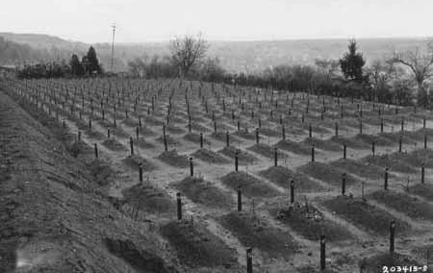
Cemetery of the Hadamar “Euthanasia” Center
This photograph was taken toward the end of the war. Hadamar, April 1945 (NARA Photo).
Notes:
*
http://www.jewishvirtuallibrary.org/jsource/Holocaust/t4.html
The T-4 Euthanasia Program
In the fall of 1939 the German government established, under the Reich Chancellery, the Euthanasie Programme under the direction of Philip Bouhler and Dr. Karl Brandt. The headquarters of the operation were at Tiergartenstrasse 4, Berlin and the code name for the program was derived from that address—T-4.
The choice of terminology for the program is consistent with the Nazis' penchant for euphemism. Euthanasia typically means "mercy killing" and in the 1990's in the United States and other western nations, it is synonymous with "physician-assisted suicide." The kind of killing carried out through the T-4 program bears little resemblance to contemporary concepts of euthanasia.
Hartheim Castle, a "euthanasia" killing center where the physically and mentally disabled were killed by gassing and lethal injection. Hartheim, Austria (USHMM Photo).
Hitler'sHitler's rise to power produced a completely new set of definitions. Guided by the over-riding principles of racial hygiene, racial purity, and national health, the Nazi regime seems fairly consistently committed to the removal of those unfit to live and produce inferior offspring. In 1935, the Nuremberg LawsHitler's rise to power produced a completely new set of definitions. Guided by the over-riding principles of racial hygiene, racial purity, and national health, the Nazi regime seems fairly consistently committed to the removal of those unfit to live and produce inferior offspring. In 1935, the Nuremberg Laws provided for the forced sterilization of the unfit. Not only did Hitler have in mind such "inferior races" as Jews and Gypsies, he also included unfit Aryans—the mentally defective, severely handicapped, the incurably insane and the incurably sick.
To implement the euthanasia program, special carbon-monoxide chambers were constructed. According to Milton Meltzer:
Between December 1939 and August 1941, about 50,000 to 60,000 Germans—children and adults—were secretly killed by lethal injections or in gassing installations designed to look like shower stalls. It was a foretast of Auschwitz. The victims were taken from the medical institution and put to death.... (Never to Forget, New York:HarperCollins, 1976:131.)
Robert J. Lifton makes the following assessment:
Of the number of people killed in the T4 and the 14f13 projects, the following statistics are usually given: adult mental patients from institutions, 80,000 to 100,000; children in institutions, 5,000; special action against Jews in institutions, 1,000; concentration camp inmates transported to killing centers (14f13), 20,000 (Klee estimated that at the end of 1941, some 93,521 `beds' had been emptied for other uses [70,000 patients gassed, plus over 20,000 dead through starvation and medication] - in other words approximately one-third of the places for the mentally ill.) But these figures may well be too low; twice these numbers of people may have perished. The fact is that we do not know and shall probably never know. Elements of deception, imposed chaos, and the destruction of many records make anything like an accurate estimate impossible.
The same is true concerning the total number of people murdered at specific killing centers. Hartheim victims of both ordinary `euthanasia' and 14f13 are variously estimated from 20,000 (by Dr. Georg Renno, Lonauer's successor as director), to 400,000 (by Franz Ziereis, the former commandant of Mauthausen, on his deathbed); 30,000 is believed to be the best estimate. While these figures may seem unimpressive when placed next to the millions killed in the Final Solution, they represent the murder of shockingly large numbers of people—all in places characterized as hospitals." (The Nazi Doctors: Medical Killing and the Psychology of Genocide. London: Papermac, 1986 (Reprinted 1990) p. 142).
Hans-Heinrich Wilhelm informs us:
The first large-scale euthanasia action seems to have taken place in Pomerania and estern Prussia shortly after the Polish campaign. During 1940, four euthanasia institutions went into operation: Grafeneck, in January, Brandenburg, in February, Hartheim, in May and Sonnenstein, in June. In the first half of the year, 8,765 persons were gassed in these four institutions, three-quarters of them in May and June, a time when world attention was focused on the Battle of France. By the end of 1940, a total of 26,459 patients had been put to death, and in the first eight months of 1941, an additional 35,049 were "disinfected." These were the figures given by the accounting section of T4's head office. ("The Euthanasia Program," in The Encyclopedia of the Holocaust, Vol II, pp.452-454)
Robert E. Conot makes the important connection between the euthanasia program and the Final Solution:
"Concurrent with the start-up of the euthanasia exterminations, Hitler authorized Himmler to establish a Race and Resettlement Office under the aegis of the SS. It was the Race and Resettlement Office that was to be responsible for the `racial' purification of the Reich and the establishment of a Nordic empire. On October 17, 1939, Keitel summoned the victorious Wehrmacht generals for a lecture from the Fu"hrer, who ranted: `The increased severity of the racial struggle permits of no legal restrictions. Jews, Poles, and similar trash are to be cleared from the old and new Reich territories.' Eight million Poles and 800,000 Jews were to be transported from the annexed portion of Poland into the government-general, and replaced by ethnic Germans repatriated from the Baltic lands, the Balkans, Russia, and the Italian Tyrol—even though, in large part, these Germans had emigrated generations before.
To `render harmless' the Polish intelligensia, political and religious leaders, Jews, and anyone else who might, theoretically, rally an opposition, Heydrich established SS EinsatzgruppenTo `render harmless' the Polish intelligensia, political and religious leaders, Jews, and anyone else who might, theoretically, rally an opposition, Heydrich established SS Einsatzgruppen (action groups). The Einsatzgruppen rampaged over the land, terrorizing and killing. Selections for execution were haphazard. Sometimes the commandos erred and included ethnic Germans whom they mistook for Jews. Shootings were carried out publicly to heighten the climate of fear. A Werhmacht intelligence officer reported: `Arrests were almost always accompanied by looting. Evacuations were carried out and blocks of houses were cleared at random, the inhabitants loaded into lorries at night, then taken to concentration camps. Actions against the Jews were carried out with the most serious excesses. A number of Jews were driven into a synagogue, where they had to crawl, singing, between the benches. Forced to take down their trousers, they were continuously whipped by the SS men on their bare behinds. A Jew who out of fright dirtied himself was forced to smear the excrement onto the faces of the other Jews.
`After about fifty Jews, who had been used during the day to repair a bridge, finished their work in the evening, two SS men drove them into a synagogue and shot them all without any reason.' (Judgement At Nuremberg, New York: Harper & Row, 1983, pp 211-212.
The euthanasia program proved to be a valuable precursor to the atrocities which were to come in connection with the "Final Solution." SS Major Christian Wirth was transferred from his duties at a euthanasia center to take over the supervision of ChelmnoThe euthanasia program proved to be a valuable precursor to the atrocities which were to come in connection with the "Final Solution." SS Major Christian Wirth was transferred from his duties at a euthanasia center to take over the supervision of Chelmno, the first of six extermination camps in Poland to become operational. His expertise in mass extermination seems to have been a major consideration. Wirth later served at BelzecThe euthanasia program proved to be a valuable precursor to the atrocities which were to come in connection with the "Final Solution." SS Major Christian Wirth was transferred from his duties at a euthanasia center to take over the supervision of Chelmno, the first of six extermination camps in Poland to become operational. His expertise in mass extermination seems to have been a major consideration. Wirth later served at Belzec, Treblinka and SobiborThe euthanasia program proved to be a valuable precursor to the atrocities which were to come in connection with the "Final Solution." SS Major Christian Wirth was transferred from his duties at a euthanasia center to take over the supervision of Chelmno, the first of six extermination camps in Poland to become operational. His expertise in mass extermination seems to have been a major consideration. Wirth later served at Belzec, Treblinka and Sobibor. In 1940, Franz Stabgl was transferred from one of the euthanasia centers to SobiborThe euthanasia program proved to be a valuable precursor to the atrocities which were to come in connection with the "Final Solution." SS Major Christian Wirth was transferred from his duties at a euthanasia center to take over the supervision of Chelmno, the first of six extermination camps in Poland to become operational. His expertise in mass extermination seems to have been a major consideration. Wirth later served at Belzec, Treblinka and Sobibor. In 1940, Franz Stabgl was transferred from one of the euthanasia centers to Sobibor extermination camp where he served as camp commander. He performed so well there that he was transferred in the summer of 1942 to Treblinka [Many years later, in 1970, Stangl was extradited from Brazil to West Germany to stand trial. He was found guilty of joint responsibility for the murder of 900,000 Jews]. After the Wannsee ConferenceThe euthanasia program proved to be a valuable precursor to the atrocities which were to come in connection with the "Final Solution." SS Major Christian Wirth was transferred from his duties at a euthanasia center to take over the supervision of Chelmno, the first of six extermination camps in Poland to become operational. His expertise in mass extermination seems to have been a major consideration. Wirth later served at Belzec, Treblinka and Sobibor. In 1940, Franz Stabgl was transferred from one of the euthanasia centers to Sobibor extermination camp where he served as camp commander. He performed so well there that he was transferred in the summer of 1942 to Treblinka [Many years later, in 1970, Stangl was extradited from Brazil to West Germany to stand trial. He was found guilty of joint responsibility for the murder of 900,000 Jews]. After the Wannsee Conference in 1942, the staff of Euthanasia Program was transferred to Operation Reinhard.
Cemetery at Hadamar where victims of “euthanasia” at the Hadamar “euthanasia” killing center were buried. This photograph was taken toward the end of the war. Hadamar, April 1945 (NARA Photo).
Source: The Holocaust\Shoah Page

Slide 6
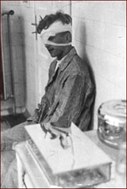
Background Information
Nazi doctors conducted as many as 30 different types of experiments of concentration camp inmates.
They did these without consent of the victims who suffered indescribable pain, mutilation, permanent disability, or in the case of many…death.

Slide 7
Freezing Experiments
Used to determine two things:
how long a body can withstand freezing temperatures before death
can a frozen victim be resuscitated
Two methods:
Icy vat
naked victim placed in freezing cold water
probe that measure temperature inserted into rectum and held in place with metal ring
Stretcher
naked victim strapped to a stretcher and left outside in sub-zero temperature
Resuscitation Experiments
Sun Lamp
victim placed under lamps so hot they burnt the skin
Clandestine photograph of a Polish political prisoner and medical experimentation victim in the Ravensbrück concentration camp. Pictured is Maria Kusmierczuk. Her leg was disfigured by injections of tetanus bacteria as part of medical experiments carried out in the camp. October 1944.

Slide 8
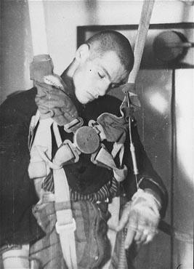
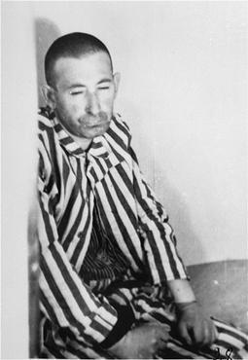
Internal Irrigation
boiling water forcefully irrigated into victim’s stomach, bladder, and intestines
Hot Bath
victim placed in hot water, heat slowly raised
most successful method
many still died of shock
Body Heat
frozen victim forced to copulate
Low Pressure Experiments
Used to determine how high Nazi pilots could fly
Victims exposed to deadly amounts of air pressure

Slide 9
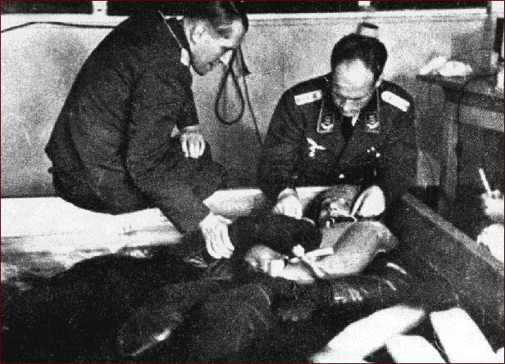
"It was the worst experiment ever made. Two Russian officers were brought from the prison barracks. Rascher had them stripped and they had to go into the vat naked. Hour after hour went by, and whereas usually unconsciousness from the cold set in after 60 minutes at the latest, the two men in this case still responded fully after two and a half hours.
All appeals to Rascher to put them to sleep by injection were fruitless. After the third hour one of the Russians said to the other, 'Comrade, please tell the officer to shoot us.' The other replied that he expected no mercy from this Fascist dog. The two shook hands with a 'Farewell, Comrade' ... These words were translated to Rascher by a young Pole, though in a somewhat different form. Rascher went to his office. The young Pole at once tried to chloroform the two victims, but Rascher came back at once, threatening us with his gun ... The test lasted at least five hours before death supervened."
--Walter Neff, Auschwitz prisoner who served as Dr. Rascher's medical orderly

Slide 10
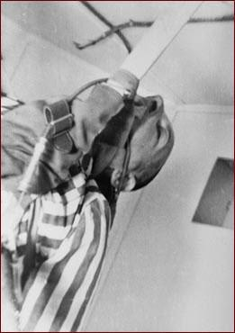
"The third experiment ... took such an extraordinary course that I called an SS physician of the camp as witness, since I had worked on these experiments all by myself. It was a continuous experiment without oxygen at a [simulated] height of 12 kilometers [39,283 feet] conducted on a 37-year-old Jew in good general condition. Breathing continued up to 30 minutes.
After four minutes the experimental subject began to perspire and wiggle his head, after five minutes cramps occurred, between six and ten minutes breathing increased in speed and the experimental subject became unconscious; from 11 to 30 minutes breathing slowed down to three breaths per minute, finally stopping altogether."
A prisoner during low-pressure experimentation at Dachau, 1942.
--Dr. Sigmund Rascher to Heinrich Himmler, 1942 Dachau..

Slide 11
Poison
Researchers at Buchenwald concentration camp developed a method of individual execution by injecting Russian prisoners with phenol and cyanide.
Experimenters also tested various poisons on the human body by secreting noxious chemicals in prisoners' food or shooting inmates with poison bullets.
Victims who did not die during these experiments were killed to allow the experimenters to perform autopsies

Slide 12
Phosgene
Fort Ney near Strasbourg, France
An attempt to find an antidote to phosgene, a toxic gas used as a weapon during World War I
Nazi doctors exposed 52 concentration-camp prisoners to the gas
Phosgene gas causes extreme irritation to the lungs.
Many of the prisoners, who according to German records were already weak and malnourished, suffered pulmonary edema after exposure, and four of them died from the experiments.

Slide 13
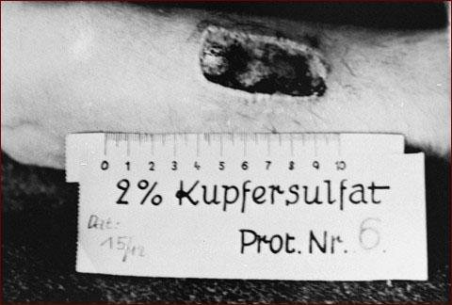
To test how to treat phosphorus burns, doctors at Ravensbruck concentration camp applied a mixture of phosphorus and rubber to inmates' skin, ignited it, and let it burn for 20 seconds.
http://www.pbs.org/wgbh/nova/holocaust/experin03.html

Slide 14
Seawater
Dr. Hans Eppinger and others at Dachau
conducted experiments on how to make seawater drinkable.
The doctors forced roughly 90 Gypsies to drink only seawater while also depriving them of food.
Gypsies became so dehydrated that they reportedly licked floors after they had been mopped just to get a drop of fresh water.
The experiments caused enormous pain and suffering and resulted in serious bodily injury.

Slide 15
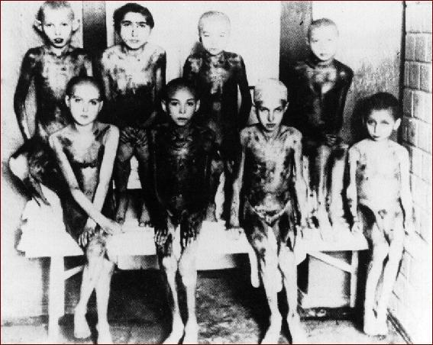
Eight of the many hundreds of children whom Nazi doctors experimented upon at Auschwitz.
http://www.pbs.org/wgbh/nova/holocaust/experin04.html

Slide 16
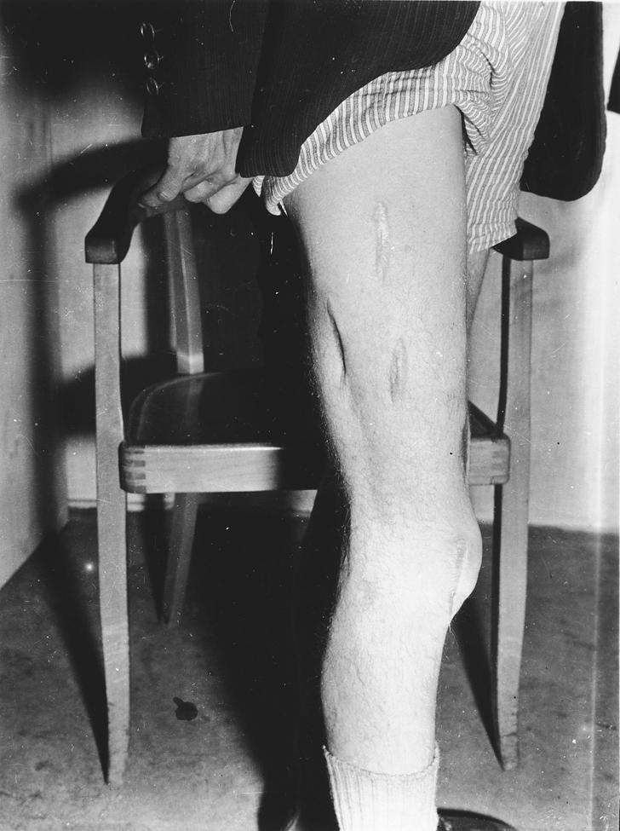
Genetic Experiments
Conducted by Josef Mengele
Attempted to determine Aryan superiority
Experiments on twins
Bodies photographed, measured, and x-rays
Substantial amounts of body hair plucked out by the root
Totally shaven of all other hair
Photographed again
Several two liter enemas
Strapped to a bench, rectums hyper extended
Extensive lower intestinal examination
Urological examination

Slide 17
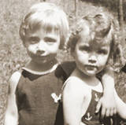
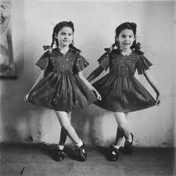
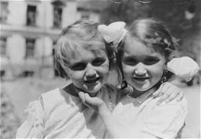
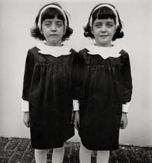
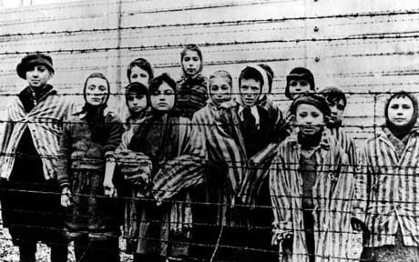
Tissue samples taken from kidneys, prostrate, and testicles
Semen samples forcefully taken
All experiments conducted without anesthesia
Twins gagged to prevent screaming
Killed simultaneously by an injection to the heart
Bodies dissected, organs sent to research labs

Slide 18
"Fifteen girls aged 17 to 18 years old. The girls who survived the following operations are in German hands and little is known about them. The subjects were placed in an ultra-short-wave field. One electrode was placed on the abdomen and another on the vulva. The rays were focused on the ovaries. The ovaries were consequently burned up. Owing to faulty doses several had serious burns of the abdomen and vulva. One died as a result of these burns alone. The others were sent to another concentration camp where some were put in hospital and others made to work. After a month they returned to Auschwitz where control operations were performed. Sagittal and transverse sections of the ovaries were made. The girls altered entirely owing to hormonal changes. They looked just like old women. Often they were laid up for months owing to the wounds of the operations becoming septic. Several died as a result of sepsis."
--Sterilization experiment at Auschwitz, as described by two Dutch doctors who had been prisoners there.

Slide 19
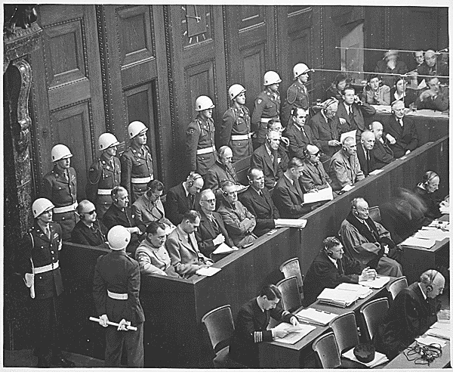
During the second World War, Nazi human experimentation occurred in Germany.
At war's conclusion, 23 Nazi doctors and scientists were tried for the murder of concentration camp inmates who were used as research subjects.
Of the 23 professionals tried at Nuremberg, 15 were convicted.
Seven of them were condemned to death by hanging and eight received prison sentences from 10 years to life.
Eight professionals were acquitted. (Mitscherlich 1992)
Nuremberg Trial
Notes:
*
http://en.wikipedia.org/wiki/Human_experimentation

Slide 20
Nuremberg Code
The result of the Nuremberg trial was the Nuremberg Code. It includes the following guidelines, among others, for researchers:
Informed consent is essential.
Research should be based on prior animal work.
The risks should be justified by the anticipated benefits.
Research must be conducted by qualified scientists.
Physical and mental suffering must be avoided.
Research in which death or disabling injury is expected should not be conducted.
Notes:
*
http://en.wikipedia.org/wiki/Human_experimentation

