Slide 1
Judaism
The Modern Jewish World

Slide 2
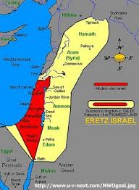
History of Judaism
Followers knows as Jews
One of the oldest religions in the world
Established in the Middle East in about 1500 B.C.E
Christianity and Islam were influenced by Judaism
Adherence to their beliefs, customs and identity has allowed the to survive

Slide 3
Terms-Hebrew
Hebrew, Israelite, Jew and Israeli have been used to describe followers of Judaism
Hebrews- people of various tribes who accepted Yahwey as their one god
- word has also meant “outsider” or “wanderer”
lived from the earliest time to the end of the second millenium BCE

Slide 4
Terms-Israelite
Israelites- descendants of Hebrews, joined by other peoples
created the united nation of ancient Israel around 1025 BCE
term used to describe the people of the Northern Kingdom of Israel from 922 to 722 BCE

Slide 5
Term- Jew
Term comes from yehudah, or Judah
Judah, the Southern Kingdom of Israel- 922-586 BCE
Became more formally a religious state
Dedicated to live as God’s loyal followers
Scattered throughout the world after 70 CE-Diaspora
Later become shortened to Jew
Used today to refer to members of a religious or cultural group
Someone is a Jew if their mother was a Jew or converted to Judaism
Home establish in Israel- all Jews can become Israelis

Slide 6
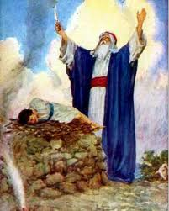
Basic Beliefs of Judaism
1.One Universal God-Yahweh
Creator of the Universe, is eternal, perfect, all-knowing, holy, and without physical form
2. Jews were specifically chosen by God to receive his law
-examples of this are the covenants, or agreements, between God and humans-Ex: Abraham to be father of the nation that would live in the Promised Land of Canaan

Slide 7
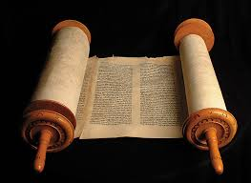
The Law
Written in the Torah- holy scripture of the Jews
2 basic codes of ethics
Love God above all things
Love Thy neighbor as thyself
Respect for the family, charitable works to help the sick, poor and elderly; and education of the young
Rewards for those that follow the Law and punishments for those who disobey

Slide 8
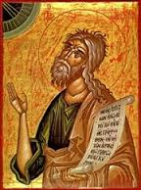
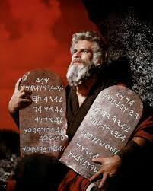
The Prophets
Moses, Samuel, Amos, Isaiah, Jeremiah and Ezekiel
Ancient time priest helped individuals to pray to God and to obey the Law.
Nowadays, individuals pray directly to God
Religious leaders are Rabbis- responsible for studying, interpreting, examining the Law to the people

Slide 9
The Messiah
The Savior
Believed to come to Earth in human form
Will rule a perfect world- lead those that follow the Law and punish those that disobey
Israel with be the land he rules and will lead a worldly example
Some branches believe the Messiah will bring peace and love among all nations as an inspiring leader

Slide 10
Observing the Sabbath
Saturday are days of rest
Ancient belief that they should not do any work and observe their religion

Slide 11
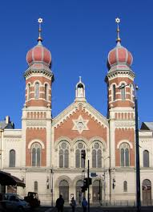
Synagogue
Jewish place of assembly
Prayer services are led by a Rabbi and cantor (special religious singers)
Special days in the synagogue are Sabbath services and the services of holy days

Slide 12
Calendar
Most holy days:
Yom Kippur-Day of Atonement
Rosh Hashanah-Jewish New Year
Sukkot-Feast of Tabernacles
Purim-celebrate the rescue of the Jews of ancient Persia from a plot to destroy them
Pesach- commemorates the Jewish Exodus from Egypt
All holidays recall historical events and put a focus on the family as central support for Jewish Religion

Slide 13
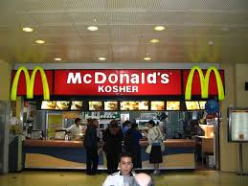
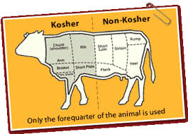
Kosher Food
Food needs to be Kosher- “fitting” or “proper”
Meats include only meats from animals that chew their cud and have cloven hoofs
Only fish with gills and scales
Must be butchered according to special rabbinical rituals
Milk and meat may not be eaten at the same meal

Slide 14
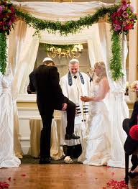
Rites of Passage
Ceremonies performed to mark important milestones in life-birth, marriage and death
8th day of life, boys are ritually circumcised- Abraham’s covenant with God
Marriage- man and woman stand under a chuppah to symbolize their union
Groom breaks a glass under his foot to symbolize the destruction of the ancient Temple in Jerusalem

Slide 15
Mourning the Dead
When a parent dies, children tear the clothing over their hearts-other relative, clothing on the right side
-First day or two between death and burial, no one visits the mourners so they can concentrate on the dead
7 days after the burial, mourners do not work or do anything for pleasure
30 days after the death, do not got to parties or listen to music
Parents mourn a child’s death for 12 months by reciting the Memorial prayer, Kaddish

Slide 16
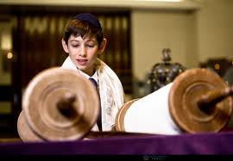
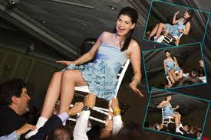
Bar Mitzvah
Boys are responsible for their own actions at 13
Boys become Bar Mitzvah- son of Commandment
Boys read from the Torah and gives an explanation in front of friends and family
Ceremony is followed by a celebration that embraces the whole family
Girls equivalent age for Bar Mitzvah is 12

Slide 17
Who Is A Jew?
2 ways to become a Jew-born or convert
A baby must have a Jewish mother by tradition- identity of the father is not always known but the identity of the mother is.
Once you are Jewish, you are always Jewish- even if you convert to another religion-Jewish Law

Slide 18
How To Convert To Judaism
Formal process of conversion
Step 1: Learn Jewish laws and customs- start living them
Step 2: Take an oral or written exam before a Beit Din(rabbinical court)
If pass, boys are circumcised- if already, symbolic drop of blood is taken
Step3: Immersion in water to symbolize their purification- mikveh
Step 4: Given Jewish name

Slide 19
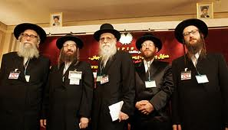
Branches of Judaism
UK and Europe- Orthodox, Reform, Liberal
USA-Orthodox, Conservative, Reform
Orthodox-most traditional-observe the laws of the Torah to the letter
men wear black coats and hats modeled on 18th century Polish wear-often have two curly locks in front of hair
services are in Hebrew

Slide 20
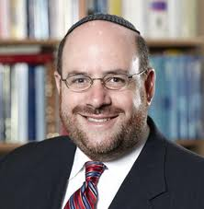
Conservative (Reform in UK)
Comprise more than ⅓ of the world’s Jews
More relaxed about some of the laws
Don’t follow dietary laws
Don’t stop working on the Sabbath

Slide 21
Reform Judaism(Liberal in UK)
Services are held in the local language as well as Hebrew
Allow women prominent role as well as Rabbis

Slide 22
Rosh Hashanah
Two day taken for the New Year
Messengers not sent out on New Years day so no one knew for sure when the new year began so they celebrated and observed religious law on both possible days
Reform Jews observe only one day

Slide 23
Jews Learning About Judaism
Begins in the home- mothers are traditionally the family’s Jewish educator
Synagogues are centers of Judaism education
children attend cheder-learn Hebrew and study parts of the Torah and Talmud
attend from about 5 years old
Adults attend Bible studies and most synagogues have a large library
Yeshiva(academy)- offers academic and religious classes
Universities or seminaries are available for Rabinical studies

