Slide 1
Totalitarian State
The Third Reich Begins

Slide 2
Establishing a Totalitarian State
Totalitarian State- government has full control of every aspect of life- things are done for the greater state, individualism doesn’t matter
Without Warrant or Trial- searched homes, tapped telephones, opened mail, imprisoned and executed innocent persons
No rights, no freedom of choice, no privacy
Spread fear

Slide 3
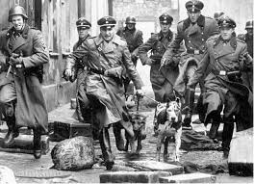
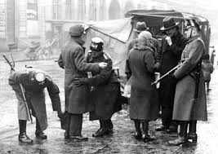
Gestapo
Blended in and snooped for enemies of the state
Unlimit powers to arrest, jail or kill anyone
Loyal Nazi judges and lawyers would not
interfere with Gestapo
Learn to keep your mouth shut

Slide 4
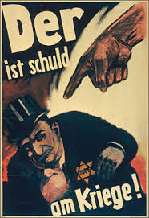
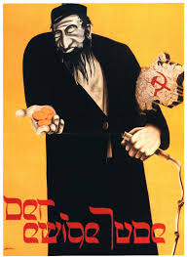
Propaganda
Slogans were drummed over and over to the public
“Jews are Germany’s enemies! They will
of the Fuehrer is the will of the people!
Aryans are the Master race!”
Soon they come to believe the Nazi ideas.
Jews are not massively attacked until most believed the propaganda

Slide 5
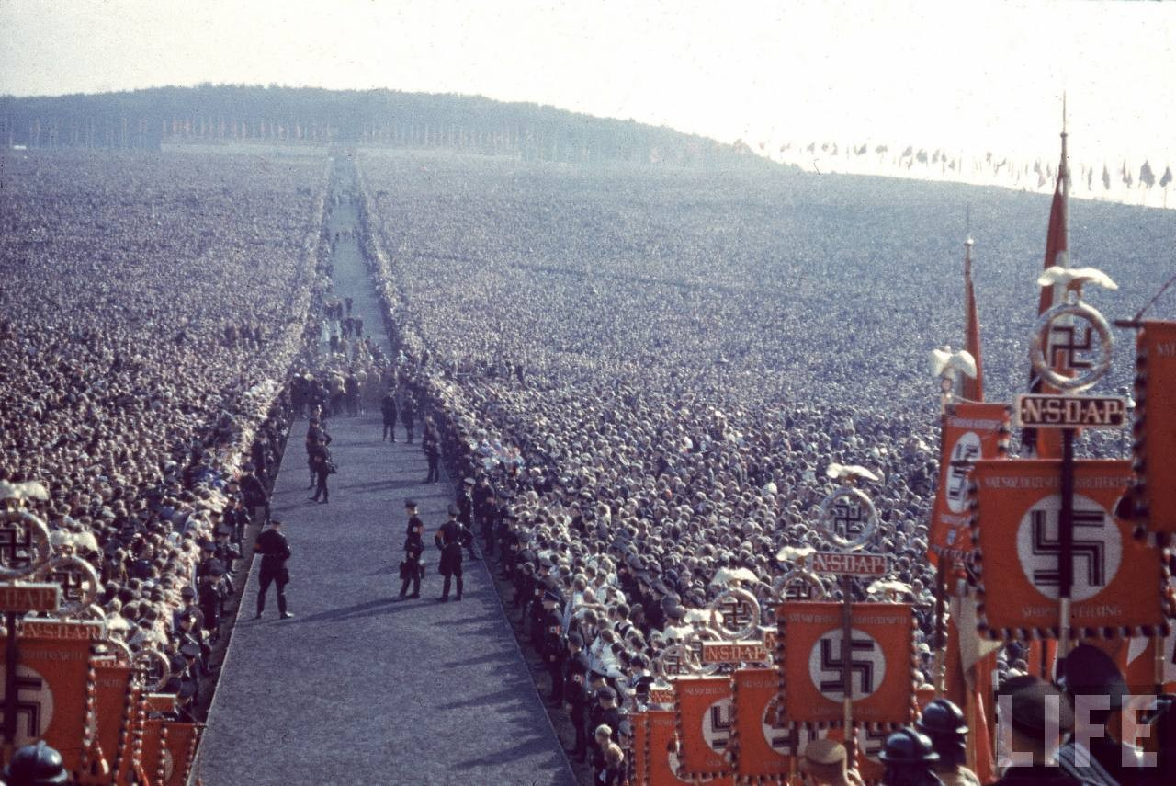
Huge Rallies
Meant to overwhelm the public with Nazi power and might
Giant-sized flags on buildings
Hundreds of thousands of uniformed soldiers
goose-stepped down the street
Swastikas on all armbands
“Who am I to questions the wisdom of the Fuehrer?”

Slide 6
https://www.youtube.com/watch?v=IkdMzSq2y2k&bpctr=1417729749

Slide 7
Nazi Control of Labor
Depression vanished as men were drafted into the armed forces, to work in factories or build autobahn- assigned work a job
autobahn- super-highway for speedy transport of troops and military equipment
Nazi leaders took all of the profits
Couldn’t strike about wages and working conditions
Long hours; less than $7 a weeks for wages

Slide 8
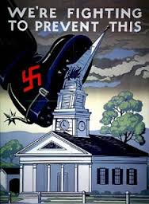
Stamping Out Christianity
Hitler thought Christianity was “Jewish invention” and Bible was “pack of lies”
Passes law for state to control church affairs-
Wants National Reich Church
Ministers were to swear an oath to
Hitler and promote his doctrines on Sunday
Those that talked against sent to
concentration camps-800 ministers

Slide 9
Roman Catholics Are Next
1933-signs concordat, treaty, with Pope Pius XII
-Catholics could manage their own affairs but stay out of politics
Hitler violates- Catholic teachers dismissed, swastika replace crucifixes, Catholic press censored and youth organizations outlawed
Thousands of nuns and priest thrown in concentration camps

Slide 10
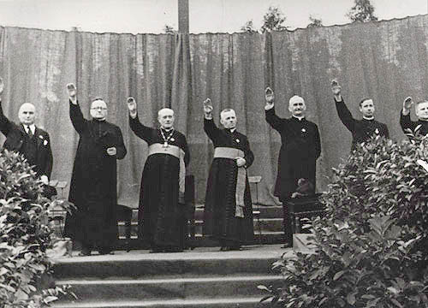
National Nazi Church
1. Swastika to replace all crucifixes.
2.Bible is banned.
3. Mein Kampf replaces Bible and is to be the basis of all religious sermons.
4. Christ was not a Jew. He was a leader who tried to rid the world of all Jews but instead was destroyed by them. Adolf Hitler is the replacement of Christ, the new Messiah who will carry on Christ’s work. Through Hitler the Third Reich will be Jew-free
Lets up on churches during the war as churches help morale

Slide 11
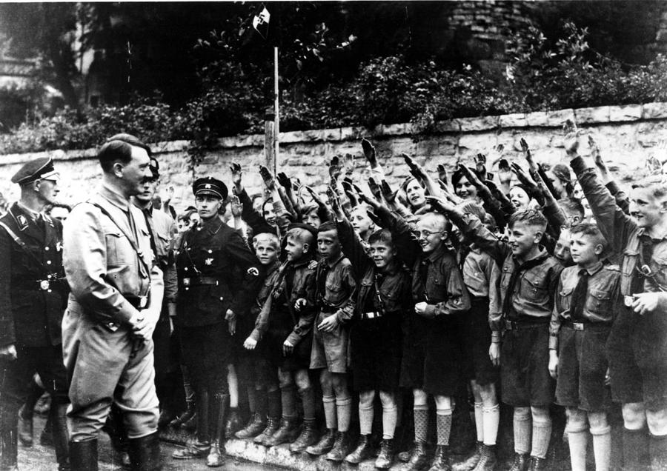
Children of the Reich-”Big Father”
Terror tactics used to keep critics in line
Could change minds of children- “Your child
belongs to us already. What are you? You will pass on!
Takes over upbringing, education a
nd leisure time of children
If parents interfered, they would
be imprisoned and their children be reared in another German home.

Slide 12
Wrecking German School System
“I do not want an intellectual education. I want young people who will grow up to frighten the world… arrogant, violent, unafraid, cruel you who must be able to suffer pain. Nothing tender and weak must be left in them!”
Every class is Nazified
Jewish teachers and professors fired
Some children so brainwashed they turn their parents in to be jailed

Slide 13
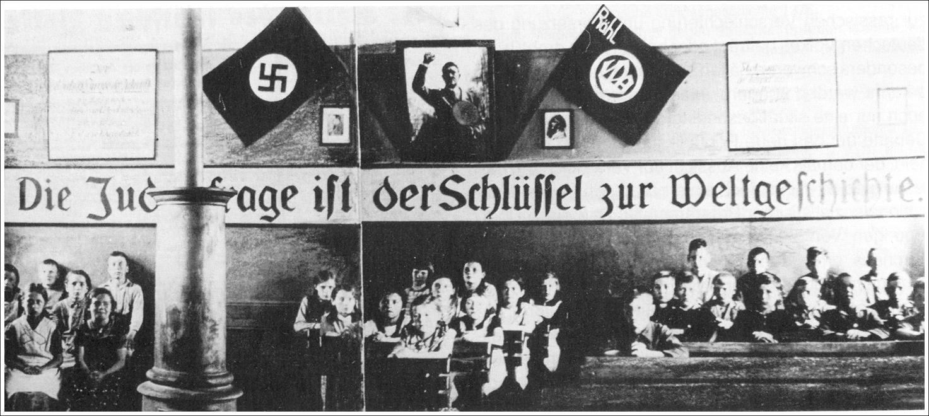
Typical School Scene in Nazi Germany
Huge picture of Hitler in class- must stand and salute it 10 times a day
Lunch prayer to Fuhrer for providing food
Nazi Teachers’ League-Swear oath and promise to use Mein Kampf as foundation of all their teaching- above all, teach to hate Jews
Textbooks rewritten- math problems contain bombs, soldiers, planes, etc.
Reading books call Jews “devil”, “scum” and “poisonous mushrooms”

Slide 14
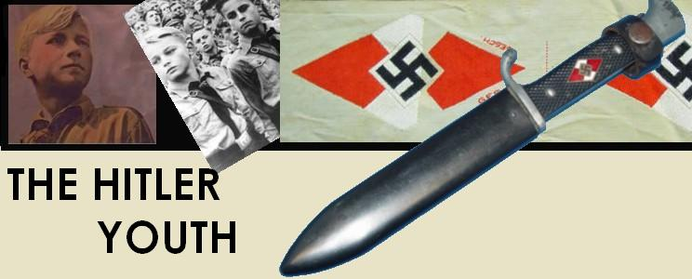
Hitler Youth
Juvenile version of German Army-boys 6-18
Drafted in- attend military camp, trained to be soldiers and study Nazism
Graduation diploma-Dagger with “Blood and Honor” engraved
Strong Leadership- six years in a special school for Nazi leaders
Nazi Labor Service-cultivated fields and built roads before 2 more years or military service

Slide 15
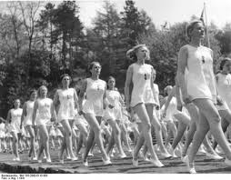
League of German Maidens
Wore uniforms and taught survival techniques
Mothering was main role-”it is your duty to bear children for the Fatherland. The Fuehrer wills it! Marriage is unimportant!”
Many teenage mothers
After high school- 1 year working on farms or in homes caring for children of large families

Slide 16
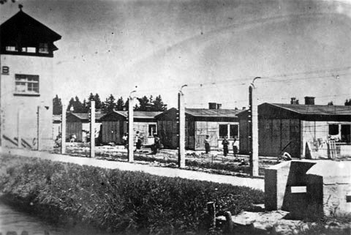
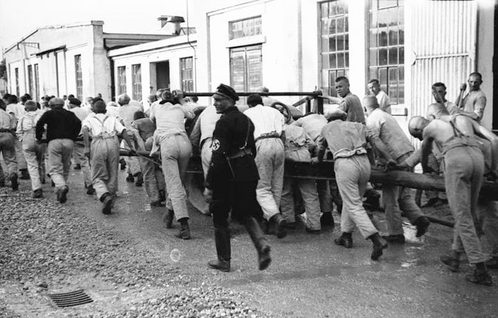
Nazi Concentration Camp or KZ
Camp Dachau - March 22, 1933
Guards commit countless crimes against prisoners everyday
Law gives camp chiefs given license to murder,starve, and torture prisoners
Chiefs chose the worst criminals to manage other prisoners-Kapos
Just as vicious as SS

Slide 17
Camp Victims
1st: Communist and socialist
2nd: Protestant and Catholic leaders and nuns, Jehovah Witnesses, Freemasons, trade union leaders, homosexuals, common criminals
25,000 in 1st year as chancellor
50 camps in one year
Open-season on Jews started 1938

Slide 19
Labor Camps
Most camps became labor camps that provided a cheap way to run industries
12-15 hour days-six days a week
Diet: Water soup, phony coffee, and a few slices of stale bread made of sawdust
If someone dies of starvation or overworked- new ones came in
Those released in earlier years were forbidden to talk about the camps or death

