Slide 1
Second Solution
To The Jewish Question

Slide 2
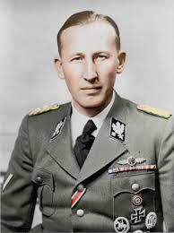
A Temporary Move
Hitler hands the Jewish problem over
to the Reich Security Office (RSHA)
Commanded by Reinhard Heydrich
Ordered to move Jews east to
Government Central-Central Poland
Ghettos is large cities with access
to major railroads
Why near railroads?

Slide 3
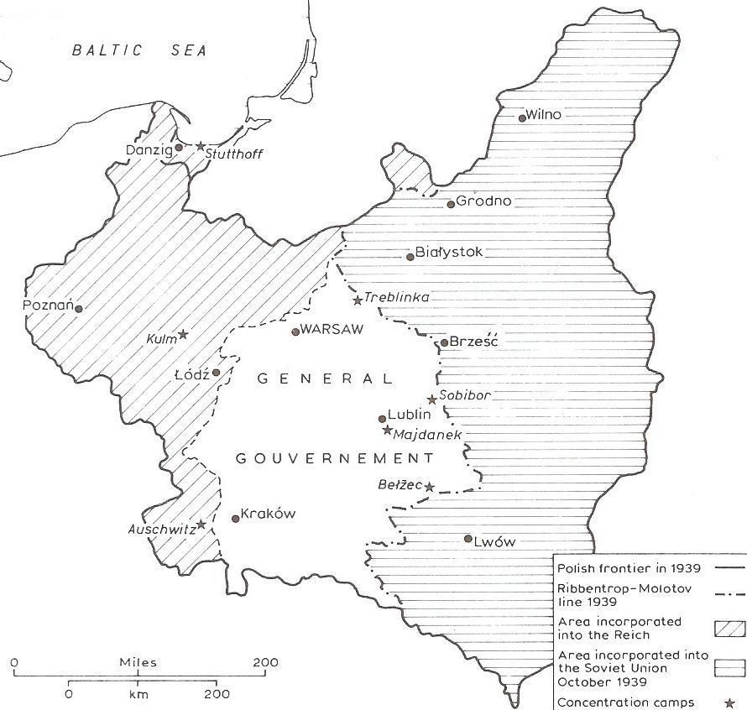

Slide 4
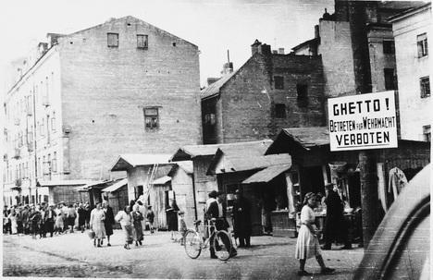

Slide 5
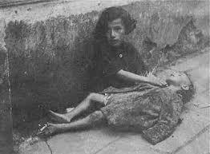
Conditions of the Ghetto Set-Up
Forced labor
Deliberate starvation policy
No medical help
Given ½ hours notice to pack-took
only what they could carry on their backs
No mass murder system was yet apparent

Slide 6
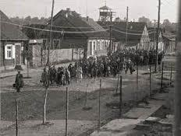
Families Walk to the Ghettos
Expected to find their own transportation
Bundles on their backs
Crying children
Elderly limping
Some tried to escape to Russia-most
were sent to Siberian labor camps or
caught in the middle of Nazi/Russian war

Slide 7
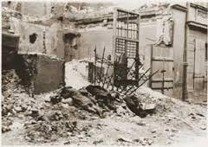
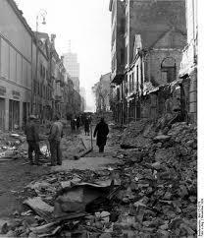
First Sight
Slums of the cities
Most buildings had been bombed out by German invasion
Severely overcrowded- whole
families in one room

Slide 8
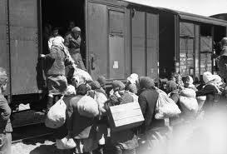
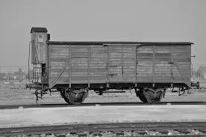
Relocation to Poland
Czech and Austrian Jews taken to Polish ghettos by cattle train
Rumors spread- people went into hiding
Suicide was common

Slide 9
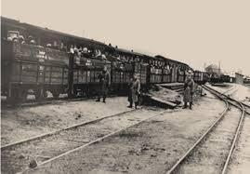
Cattle Cars
Packed so tightly, couldn’t sit
or barely breathe
Unheated, windowless
Barrels or buckets became
bathrooms
Took several days to final destination
Many got frostbite, sick or died of hunger on the way

Slide 10
A Jewish Reservation?
First location- Lublin, Poland
Mid January 1940 80,000 Jews in ghetto
Not enough housing-homeless froze in the streets
No proper sewage- water contaminated and undrinkable
Typhus and starvation killed many
By Spring of 1940 this idea was not possible

Slide 11
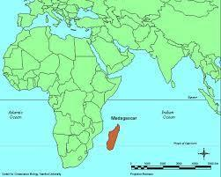
Madagascar
Still belonged to the French-had to conquer them first
Would have to ship Natives out and take 4 million Jews there
Would have to wait until the war was over
Some say reservations were a
serious consideration
Other say they were to trick
the Jews and the world from real
intentions of mass murder

Slide 12
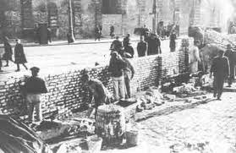
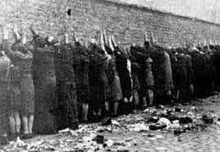
Look of the Ghettos
Walled high but not all ghettos
Prohibited to leave
No one in the streets 7P.M. - 5A.M

Slide 13
Warsaw Ghetto
Over ½ million residents- 1 mile x 1 mile square
Contaminated water supply
Tuberculosis, typhoid, and body-lice
No winter clothing
No medicine
¼ of food rationed to Germans
Worked to the bone- 12-15 hour days non-stop

Slide 14
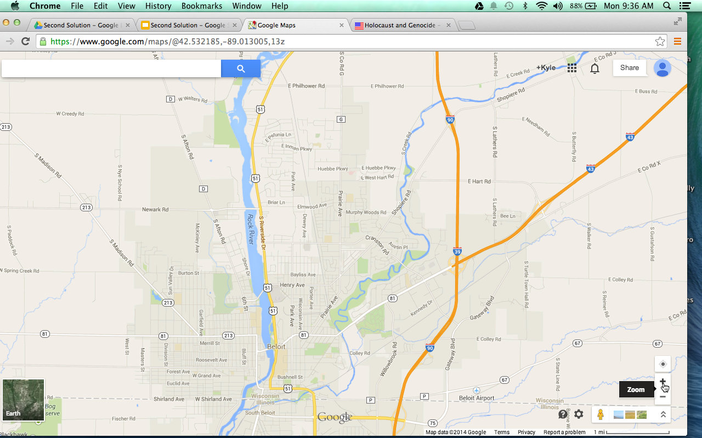
This is the approximate size of the Warsaw ghetto which had over 500,000 people living there.

Slide 15
Living Conditions in Warsaw
4 families in a space meant for one
Some in hallways, basements or attics
Dead lying in streets so common, many don’t even notice them- some got covered with newspapers
Cold froze fingers, toes and pipes-put bathrooms out of order
When coal ran out-took wood from falling windows
Two winters- 70,000 dead
Orphaned children huddled in snowy streets, barefooted, dressed in rags and begged for food

Slide 16
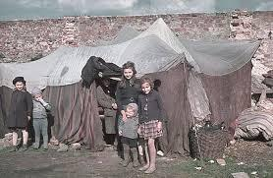
Life in Warsaw
Grew gardens where they could
even rooftops
Everyone was taxed-opened
soup kitchens with money
Children dug holes under
walls or walked through sewers to smuggle food in-fast
Some killed by SS but didn’t stop others
Schools for children and adults in back rooms

Slide 17
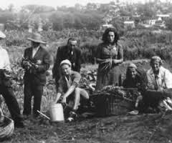
Life in Warsaw
Doctors did studies on starvation- still used today
Newspapers published- could be killed if caught
Historians kept diaries and archives
Actors put on plays
Religious services and studies remained important part of Jewish life

Slide 18
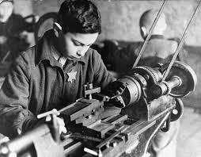
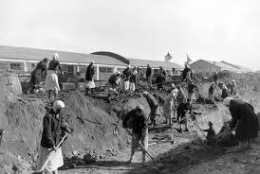
Forced Labor-Ghettos and Labor Camps
Most German men at war front
Jews ran machines and assembled
parts in armament plants
Built factories, labor camps,
bridges, railroads, air-stips, tenches,
gas chambers and crematoria
Why would they help their
enemy?

Slide 19
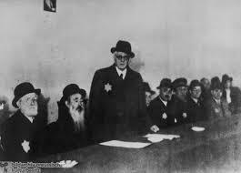
Judenrat
Jewish councils inside the ghettos-were to carry out Nazi orders
Some seen as leaders and accepted the job- others chosen, usually weak-minded people
Easier to implement your rules when representative of the people tell them to do it

Slide 20
Responsibilities of Judenrat
Set up Jewish police force-2,000 in Warsaw
Had to distribute the food-Problem?
When people refused work, Judenrat had to order Jewish police to round up those refusing
Workers damaged machines and made defective products
-killed a 100 people a day until culprits were caught

Slide 21
Judenrats Make Selections for Death Camps
1941 Final Solution was made and Nazis made Judenrat pick those to be sent
when true intentions of the camps discovered, many committed suicide
Selected beggars, the aged, ill and dying in the streets and hospitals
In the end, Judenrat and police were forced onto the trains

Slide 22
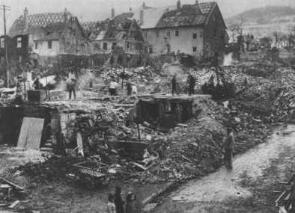
Too Many Jews
As Hitler conquered the rest of Europe, it took more time to implement Anti-Semitism
Some resisted- if caught they were killed
Fear and terror were imposed by mass shootings to put people in their place

