Slide 1
Science of Wingsuits:
Becoming a human flying squirrel

Slide 2
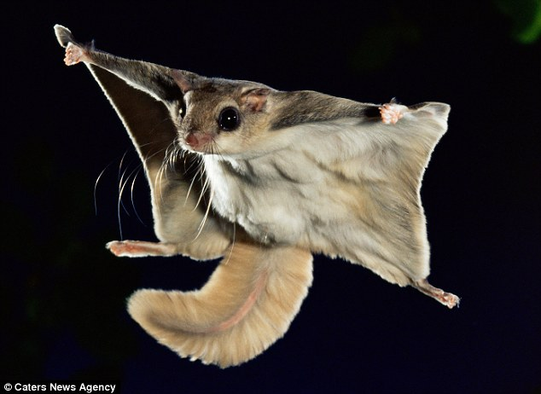
Remember These Guys?

Slide 3
Forces
Lift
Drag
Momentum
Weight
Notes:
The forces involved with wingsuits are essentially the same as every other flying thing. Weight is the force pulling the person toward the earth, lift is the force applied by the air that keeps the person aloft, and drag is the resistance caused by hitting air molecules as the person moves forward. The forward motion is primarily due to momentum in this case. Since there is nothing causing the person to move forward, there is no thrust. While there are ways to alter forward motion with a wingsuit, there is no forward propulsion.
Jumping with a wingsuit is essentially falling with style at it’s fanciest.

Slide 4
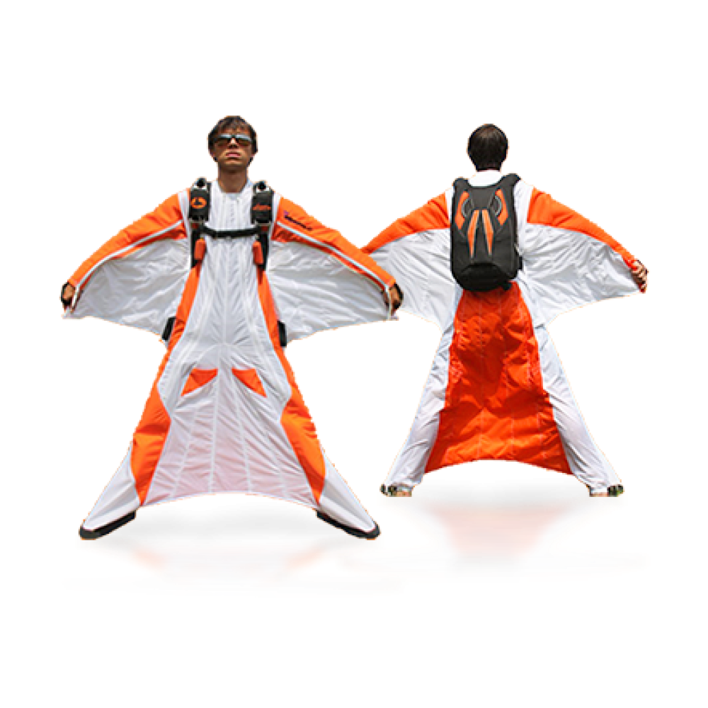
Basic Structure
Emergency Handles
Parachute
Wing Surfaces
Notes:
Notice how similar this is to the flying squirrels and other gliding critters we talked about week one.
The wingsuit itself has very little solid structure--your body provides the frame. The wing surfaces connect the legs and spread between the body’s trunk and arms.
The jumper is equipped with a parachute for landing. This includes the primary parachute and a reserve chute for safety.
Emergency handles are in place to allow easy deployment of the reserve chute.

Slide 5
How it Works
Need to start high
Falling with style
No propulsion
Maneuver by changing body position
Notes:
Wingsuits don’t work at low points. You need to start at some altitude by either jumping out of a plane or jumping off from something tall (think buildings, cliffs, trees, etc.).
Like our gliding critters, this isn’t really flight. It’s gliding. Wingsuits are really just a way to turn you into the human equivalent of a flying squirrel.
Nothing pushes the person forward, backward, up, or down (except gravity…). Flights are generally short, but can be extended with a change in body position to allow for greater harnessing of air on the way down.
There’s no steering wheel with a wingsuit. Turns are made by changing body position--for instance tilting to your left in order to turn left.

Slide 7
Who Uses These Things?
Used for recreation
Base Jumping
Sky Diving
Military potential

Slide 8
Recreational Use
BASE Jumping
Jumping from buildings, antennae, spans, or earth
Can be done with or without a wingsuit
Wingsuits add interest and an adrenaline surge

Slide 9
Recreational Use
Sky Diving
Jumping out of a plane
Can be done with or without a wingsuit
Wingsuits can allow for greater maneuverability and different aerial tricks

Slide 10
Aerial Tricks
Notes:
First minute and half--Tricks that can be performed by single person

Slide 11
Proximity Flying
Notes:
Flying close to another object--in this case two planes and other skydivers

Slide 12
Potential Military Use
Special Ops Assaults
Public Relations
Notes:
The military does not use wingsuits as advanced parachutes are more efficient and safer than the suits. A member of the Army parachute team, the Golden Knights, set the world record for a wingsuit flight distance. Beyond this public relations stunt, it has been suggested that the military employ wingsuits for special ops missions which require stealth.

Slide 13
Wingsuit Record

Slide 14
Starting Out
Experience BASE jumping or skydiving
Learn how!
Get equipment of your own
Notes:
It’s suggested that before utilizing a wingsuit for either BASE jumping or skydiving that you have jumped (for either) a LOT. (50 suggested for BASE; skydiving training and 200 jumps for skydiving)
Skydiving wingsuit courses are available and finding a BASE wingsuiter mentor is recommended. Learning how is essential to safety.
Wingsuit equipment can be purchased or rented. Either way, it’s costly! Wicked Wingsuits will rent you a wingsuit for $200 a month or you could purchase a Squirrel wingsuit (with nut sack! Ha!) for about $1500.

