Slide 1
Science of Helicopters

Slide 2
Advantages
Don’t require runways!
Can hover
Can land/maneuver well
Notes:
Since the blades of a helicopter rotate, they don’t need to move forward to create lift. That means that there’s no need for a runway to get the blades up to the proper speed. Helicopters can get the blades up to speed without moving.
Blades rotating to create lift also allows a helicopter to hover since they don’t need to move forward to stay in the air. The same principle allows helicopters to land and maneuver very specifically as well. They are better able to land in a particular spot.
Helicopters are often used for emergency situations because of these advantages.

Slide 3
Disadvantages
Limited in distance
Limited capacity
More mechanical parts
Slow
Notes:
Helicopters are best used for short distance travel as they can only hold a limited amount of fuel and it requires a lot of energy to keep the blades spinning at the right speed. Helicopters also have limited carrying capacity. More weight requires faster spinning blades or more blades to keep the helicopter at a particular altitude. Since blades can only spin so fast (due to physical limitations), the helicopters can only be so heavy and still be functional.
The number of moving parts on a helicopter is much greater than the number of moving parts on an airplane. This means that the cost of maintaining a helicopter is much greater and there is a greater potential for problems.
Due to design limitations, helicopters are not able to travel very quickly which means trips take longer.

Slide 4
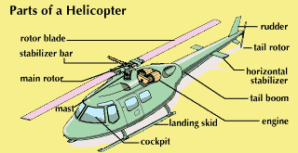
Basic Structure
Notes:
We’ll focus on a few of the most important parts to a helicopter.
Rotor blade--similar to the wing of an airplane; creates lift when spinning
Stabilizer bar--provides counterweight for rotor blades to keep helicopter balanced
Main rotor and mast work to support the stabilizer bar and rotor blades.
Engine--burns fuel to spin the rotor blades
Cockpit--area where pilot, passengers, or cargo are carried
Landing skid--provides support for the helicopter on the ground
Horizontal Stabilizer--helps keep the helicopter from tipping to either side during flight
Rudder--aids in steering the helicopter
Tail Rotor--keeps the body of the helicopter from spinning in the opposite direction of the blades

Slide 5
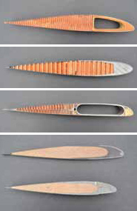
The Blades
Helicopter blades are shaped like plane wings!
This helps them create lift as they rotate.
Notes:
Remember: This shape allows the air to travel over the blade faster than it does under it, which causes the air to push the aircraft upwards.

Slide 6
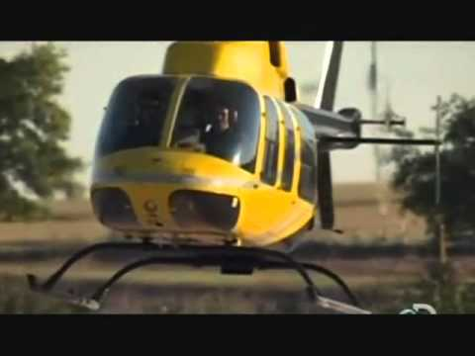
How It Works
Notes:
Stop at 2:09

Slide 7
Common Uses
Emergency transport
Rescue
Police/Military Use
Tourism
Traffic monitoring
Notes:
Patients who need to be rushed to a different hospital are transported via helicopter if an ambulance will not be fast enough.
Due to their ability to hover over a specific area, helicopters are ideal for rescue missions. They have the ability to hover over an area while a rope or ladder is lowered to retrieve the person or people in trouble. This also allows them to be used for fighting serious forest fires as they can more precisely deliver the water to the main portion of the fire.
Helicopters are used by the police and military for more precise missions. Helicopters can be used to search an area for people, vehicles, or dangers. They can be used, primarily in the military, to deliver supplies or retrieve wounded individuals. They can also be used to drop off people in areas that are difficult to reach by foot and impossible to reach by plane.
Tours of cities can be given in helicopters and can give people a good look at classic skylines or other landmarks.
Helicopters can provide an ‘eye in the sky’ to help monitor traffic in regularly congested areas.

Slide 8
Build and Experiment!
Build a paper helicopter by cutting and folding the template you were provided.
Test it.
How long does it stay in the air?
Experiment.
What can you do to make it stay in the air longer?
Notes:
http://www.msichicago.org/online-science/activities/activity-detail/activities/make-and-fly-a-helicopter/browseactivities/0/
Here are the folding instructions. You can also download the template from this website or get it from the shared folder for this section. Have them record observations and changes to their simple helicopters.

