Slide 1
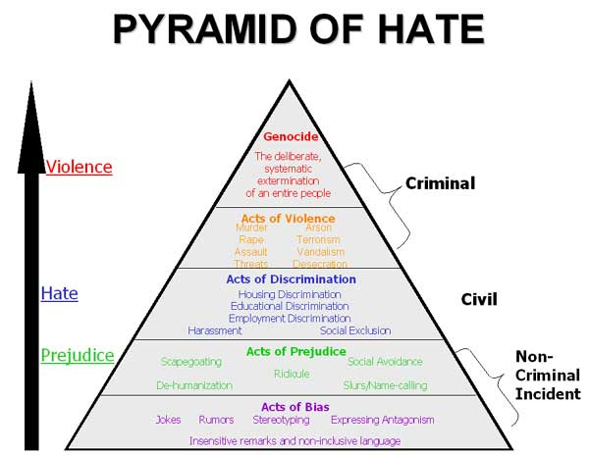
Pyramid of Hate
Genocide in Practice

Slide 2
Stereotypes - beliefs about attributes that are thought to
be characteristic of members of particular groups -
sometimes positive
Prejudice - a negative attitude or affective response
toward a certain group and its individual members
Discrimination - unfair treatment of members of a
particular group based on their membership in that
group
Scapegoat - To blame others for problems or issues

Slide 3
THE LANGUAGE OF PREJUDICE
Phrases of Color: White is pure - black is evil
Disparagement: Bad mouthing another group to gain trust or show superiority when you are the weaker person
Stereotype Language: Categorizing or grouping
Caricatures: Overemphasize a character of their features
Ethnic Jokes: A minority isn’t always the butt of a joke
Slips: Supposed to be considered accidental

Slide 4
Is this Prejudice or Discrimination?
A black father tells his son that he does
not believe he should date white women
because they are all stuck up.
PREJUDICE-it is a belief not an action.

Slide 5
Is this Prejudice or Discrimination?
A white father refuses to let his son bring
his black girlfriend into their house for
dinner.
DISCRIMINATION - because it is unfair
treatment of a person

Slide 6
Ethnic Jokes?..Is it a stereotype?
There's a black and a Mexican in a car, who's driving?
THE COP!
Why are most Italians named Tony?
When they got on the boat to America they stamped To NY (Tony) on their foreheads.
What does a white woman make for dinner?
RESERVATIONS!
What's the difference between a white man and a snake?
One is a evil, cold-blooded, venomous, slimy creature of Satan, and the other is a
snake.
Where does an Irish family go on vacation?
A Different bar

Slide 7
Questions to Discuss
Why do you think people tell ethnic jokes about other groups, insult others, or exclude them socially?
Why would these differences cause a person to “put down” someone else?
Where do people learn to disrespect people who seem different?
Can you give examples of a prejudice you have perceived and/or learned from your immediate family?

Slide 8
Can this happen here at RCAA?
In one school, a group of four boys began whispering and laughing about another boy in their school that they thought was gay. They began making comments when they walked by him in the hall. Soon, they started calling the boy insulting anti-gay slurs. By the end of the month, they had taken their harassment to another level, tripping him when he walked by and pushing him into a locker while they yelled slurs. Some time during the next month, they increased the seriousness of their conduct - they surrounded him and two boys held his arms while the others hit and kicked him. Eventually, one of the boys threatened to bring his father’s gun into school the next day to kill the boy.

Slide 9
RCAA?
Could this happen at our school?
How do they think a situation like this
could affect the entire school?
What could have been done to stop the
situation from escalating?
Who should have stopped it?

Slide 10
Where, Why, Who
Where would you place
whispering and
laughing on the
pyramid?
Why do you think that
what seemed harmless
initially progressed into
violence?
At what level of the
pyramid do you think it
would be easiest for
someone to intervene?

Slide 11
What Would you do
Anti-Semitism
Islam

