Slide 1
Parts of Propaganda
Mr. Jobb, 2015

Slide 2
Features of Propaganda
An emotional response
Frames the subject in either a positive or negative light
Employs stereotypes
Helps to construct and perpetuate groups and “others”
Uses stereotypes to convey a message
Misleading information
Creates a desired picture through confusion and misinformation
Not always the case but SIGNIFICANTLY more common in negative propaganda
Cultural values
Attempts to have a “lasting effect” by speaking to cultural values

Slide 3
Emotional Response
Positive Response
Negative response

Slide 4
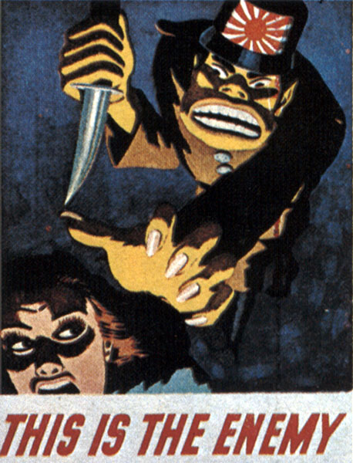
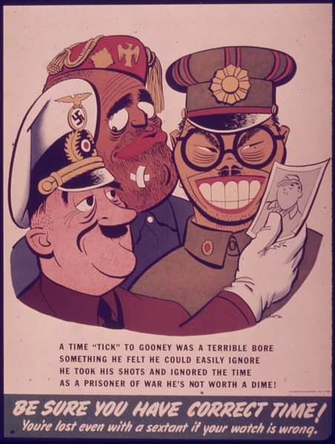
Stereotypes

Slide 5
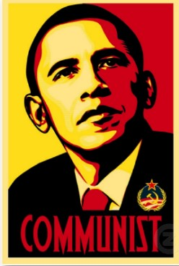
Misleading Information

Slide 6
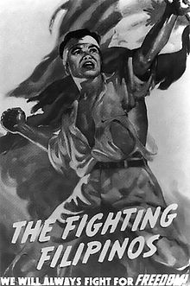
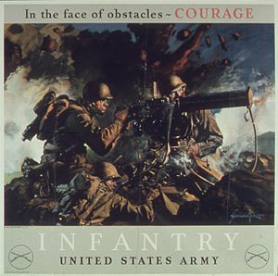
Cultural Values

Slide 7
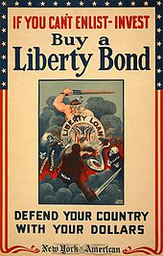
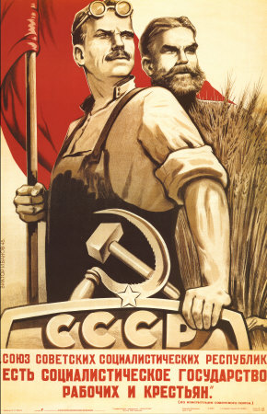

Slide 8
What do these picture tell you about members of the military?

Slide 9
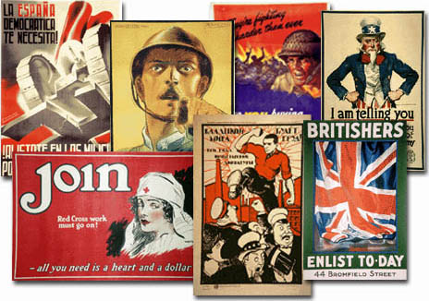

Slide 10
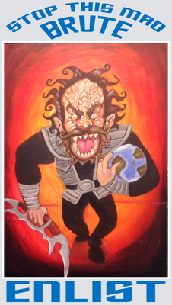

Slide 11
