Slide 1
Parts of a Rocket
Mr. Jobb, 2015

Slide 2
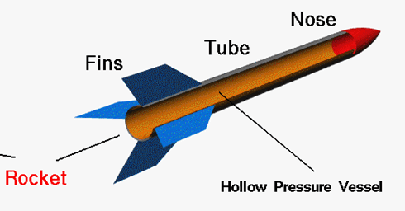

Slide 3
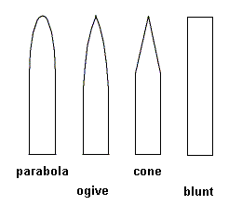
Nose Cone

Slide 4
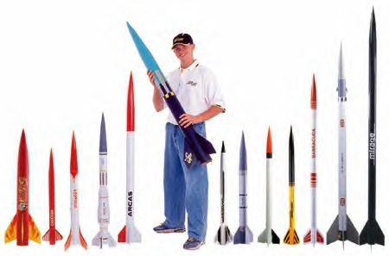
Body Shapes

Slide 5
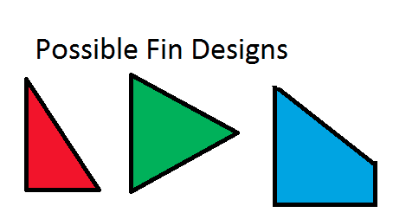
Fin Shapes

