Slide 1
Hitler and the Nazis

Slide 2
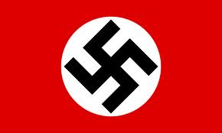
Organizer of the Nazi Party
Becomes the Der Fuehrer “the leader” of German Worker’s Party
Changes name to National Socialist German Worker’s Party-Nazi party
Motto: “Germany Awake! Perish Jewry”
Publishes and distributes Nazi newspaper
Swastika- Stood for Aryan or Nordic (German) race
White- represents nationalistic idea for a Greater Germany
Red - Nazi idea of all Germans living together
Titled on its side- Represent party movement to make Germany Jew-free and of conquering the world

Slide 3
Storm Troopers
Sturmabteilung (SA)- private army to overthrow German government
Brownshirts- for wearing brown uniforms with swastika armband
Two main goals for SA:
Create violence in street showing government couldn’t control
Destroy all opposing political parties
Ernest Rohm- Leader of SA- ties to politicians and police to keep men out of jail
Cause violent riots and severely beat opponents

Slide 4
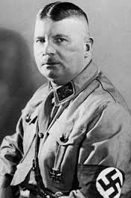
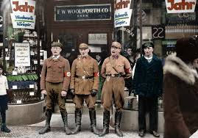

Slide 5
Germany’s Troubled Economy
Couldn’t pay war debt to France-sent troops took over a factory
Factories shut down one after another-causes hyperinflation
Frustrated workers became interested in Nazi party- 56,000 members 1923
Jews start to be beaten in the streets

Slide 6
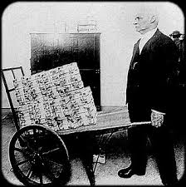
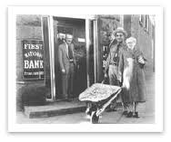
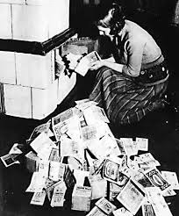

Slide 7
Beer Hall Putsch
Late 1923-Hitler wants to take Munich by coup d’etat then federal seats in Berlin
November 8, 1923- 600 SA with Enrich von Ludendorff surround a beer hall where 3000 residents and top political leader meet
Begin victory parades but police and army end it
Hitler and others arrested for treason
The Beer Hall Putsch showed Germany was not ready for Hitler

Slide 8
Trial and Prison
Convinces judge and jury he wants to make Germany better- Gets 5 years instead of death
Realizes in prison Nazis will have to get elected to Reichstag- German house of representative and take over from the inside
Sentenced 5 years- serves 8 months before released

Slide 9
Mein Kampf-My Struggle
Writes an autobioagraphy/ Nazi master plan in prison
Sells poorly at first
When he comes to power, millions buy it out of fear and duty
No one actually reads it or his future actions would have been no surprise

Slide 10
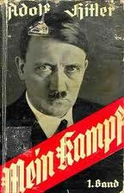

Slide 11
Nazi Creed
1. Men are not created equal
2. Jews, the most inferior race, are the true destroyers of culture
3. Slavs, blacks, and Mediterranean people only rank just above Jews
4. German master race will take as much land as it needs
5.Democracy and majority rule are stupid
6.Propaganda, a system to spread political ideas, must be used to gain support of the ingorant masses
7. Force and fear are the only means to keep the masses under control
8. Give the people one enemy to hate and blame for all their troubles
9.Thou shalt have no other God but Germany!

Slide 12
Nazi Shadow State
Shadow state- a secret, substitute Nazi government
Germany divided into 34 districts with Nazi leader- each district broken down so every corner had a Nazi leader
Departments of justice, labor, propaganda, interior, and culture
Nazi party strengthened and some leaders elected to Reichstag
Great Depression sets the stage for the shadow state- 1933 Germany and Hitler to become one

Slide 13
Hermann Goering
Became president of Reichstag
Created Gestapo- hunted down Nazi opposers
Directed the building of the first concentration camps
Became head of Luftwaffe, Germain Airforce
“ I have no conscience, my conscience is Adolf Hitler”

Slide 14
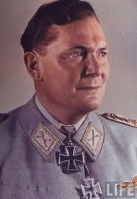

Slide 15
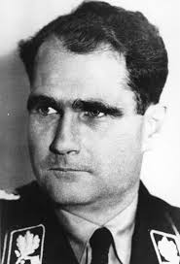
Rudolf Hess
Hitler’s 4th in command
Suffered from hallucinations and amnesia
Worshipped Hitler
Flew to England during Battle of Britain
to convince Churchill to join to Germans
against the Russians-shot down and
taken prisoner

Slide 16
Josef Goebbels
Hitler’s propaganda chief
Made sure Germans only read
books approved or written by Nazis-
all other books were burned!
May 1933- had open book burnings
Poisoned his children and committed
suicide after Hitler’s death

Slide 17
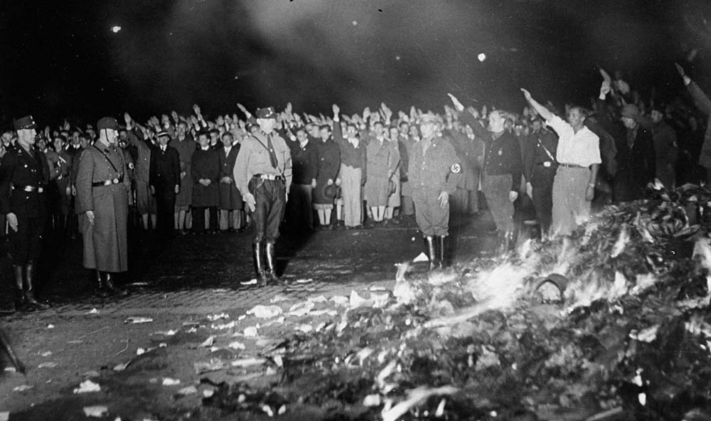

Slide 18
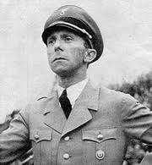
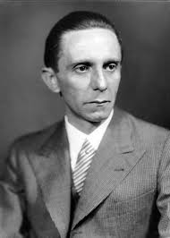

Slide 19
Alfred Rosengerg
Hitler looked up to this man
Man behind “scientific evidence” that Germans were a superior race and Jews were subhuman
Protocols of the Elders- brought this to Hitler and had it redistributed for the masses
Convinced Hitler that the “same Jewish instigators of the Russia Bolshevik Revolution of 1917 were at work in Germany

Slide 20
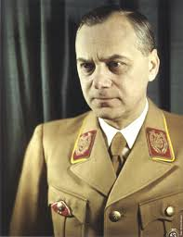
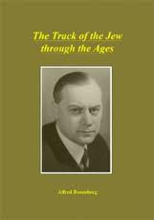

Slide 21
Heinrich Himmler
Chief of the SS-Most feared and dreaded Nazi of them all!
Man in charge of slaughtering the Jews
In command of extermination and concentration camps- personally checked the functioning of gas chambers and watched executions
Ordered doctors to perform human experiments on prisoners
Felt Jews were animals!

Slide 22
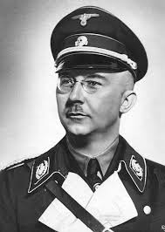
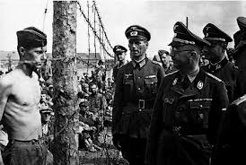

Slide 23
SS- The “Elite Guard”
Hand-picked SA members to be bodyguards of top Nazis
Schutzstaffel-”Protective Guard-Black Shirts-Hitler’s Butchers
Were to help rule the masses and were to be parents of the “pure-blooded” master race of super-people
All walks of life joined the SS
To get in had to provide family tree back to 1750- pure German
No history of hereditary diseases
Tall, blonde, blue-eyed and athletic
Made an oath to kill all enemies of the Fuehrer
No law, judge or court could punish an SS member
Received special training- were convinced they were the superior race and ate food that was suitable for their pure blood

Slide 24
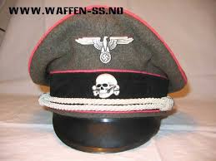
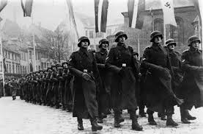
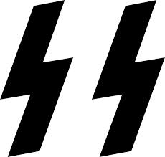

Slide 25
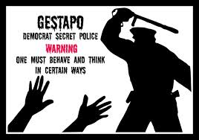
Divisions of the SS
Heads of concentration camps were members of the Death’s Head Regiment- skull and crossbones insignia on their uniforms
Gestapo- secret state police-spies living in every German neighborhood
Made arrest- searched homes without warrants, dragged people off to prison camps

Slide 26
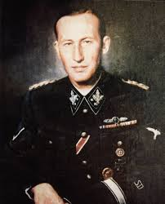
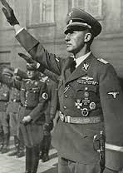
SD-Security Police
Headed by Reinhard Heydrich-3rd in command behind Hitler and Himmler
Collected intelligence information
Handled the organization and extermination of Jews

Slide 27
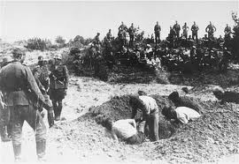
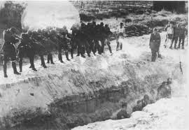
Einsatzgruppen-Political Police
Killings squads that move about, especially in Poland and Russia
Shot over one million Jews- mostly over open grave the Jews had first dug

Slide 28
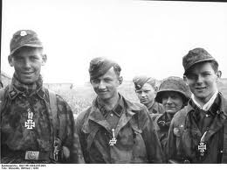
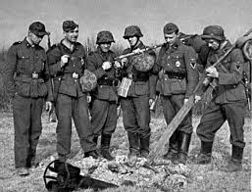
Waffen SS
SS military groups during WWII
Hunting units for Jews throughout Europe
Grew over 1 million members as Hitler allowed others that were not pure-blooded Germans

