Slide 1
History of Parachuting
Mr. Jobb, 2015

Slide 2
Origins
Nobody is quite sure…
Medieval times
China 12th century
Cliff jumps with cloth “parachutes”
Actually more similar to large umbrellas than modern parachutes
Used to entertain court officials

Slide 3
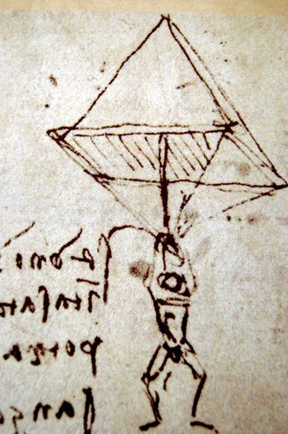
Origins
Renaissance Italy
Da Vinci
1495
First blueprints for a parachute
Rigid pyramid frame with cloth canopy
Concept was correct
Not very practical
Size, Mobility, Harness

Slide 4
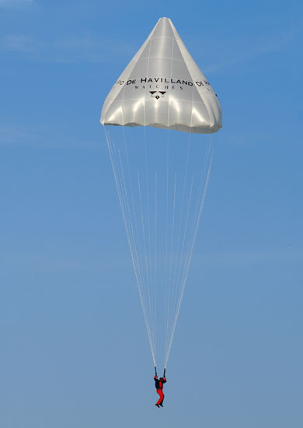
Origins
Never actually created his parachute
Note along with the designs
“If a man is provided with a length of gummed linen cloth with a length of 12 yards on each side and 12 yards high, he can jump from any great height whatsoever without injury.”
Finally jumped in April, 2008

Slide 5
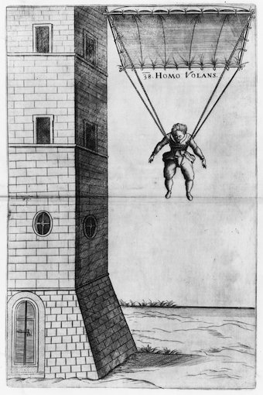
First Attempts
Faust Vrancic
1617, Homo Volans
Device similar to Da Vinci’s
Jumped from a Venice tower
Published in Machinae Novae
First recorded SUCCESSFUL European parachute jump

Slide 6
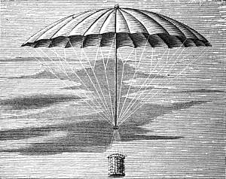
The French…AGAIN!
Jean Pierre Blanchard
1785 dropped a dog in a basket with a parachute
Used parachutes in the event of balloon accidents
Started experimenting with foldable parachutes
Normally had a rigid frame
Jacques and Andrew Garnerin
Stunt jumps from balloons
1797 – 8000 foot jump
Added a vent to the top to provide stability

Slide 7
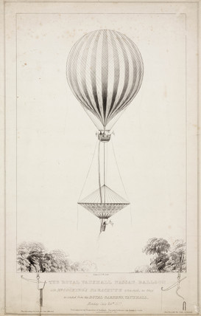
A Spectator Sport
Robert Cocking
1837 – Parachuting’s first fatality
Cone-shaped parachute became inverted
Public became less enthralled after his death
Carnival and daredevil acts
Stunts on a trapeze bar attached to a descending parachute
Parachute attached to the bottom of a balloon
Fun nicknames like “Dumbo”

Slide 8
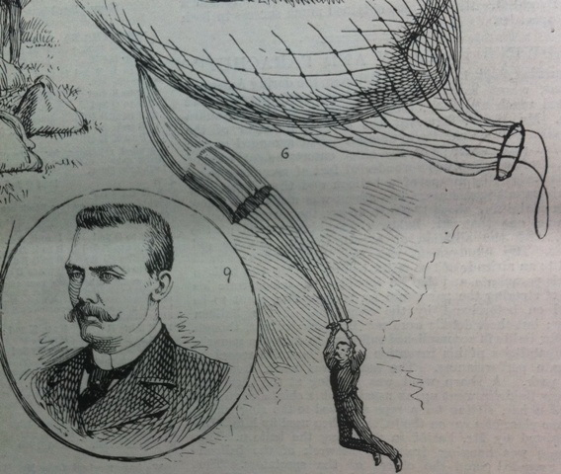
Safety First…
Invented the first harness system
Captain Thomas Baldwin, 1887
Packing parachutes
Paul Letteman and Kathchen Paulus, 1890
Knapsack like container
Cut-away system and reserve
Kathchen Paulus

Slide 9
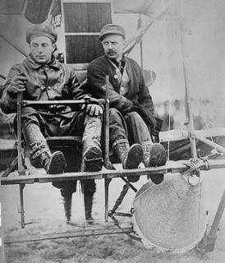
First Jumps
Grant Morton and Captain Albert Berry
1911-12, first jumps from a plane
Morton
Silk parachute folded in arms
Berry
Parachute folded in a metal case under the fuselage
Trapeze bar to hang onto

Slide 10
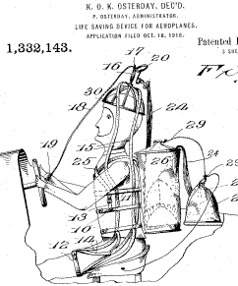
First Jumps
Pilot Chute
Pino, 1911
Small parachute with a rigid frame attached to a helmet
Catches the wind and pulls off the helmet
Pulls out the main canopy
Military skeptical
Did not believe the human body could withstand freefall for more than a few seconds before blacking out

Slide 11
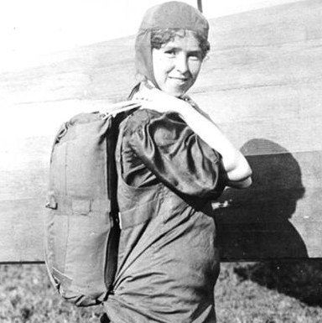
Freefall
Georgia “Tiny” Broadwick, 1914
First freefall jump
Leslie Irving and Floyd Smith, 1919
Proved military wrong
Developed the ripcord system
Barnstorming
https://www.youtube.com/watch?v=Y6wwizIzkmY
Notes:
7 minutes in

Slide 12
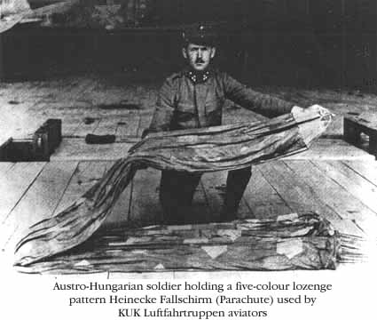
WWI and WWII
Round silk canopies the norm
Used in military air corps in Europe, Russia, and the US
Bailout system for observation balloons
Airplane pilots instructed to land with their aircraft
First airplane bailout 1922

Slide 13
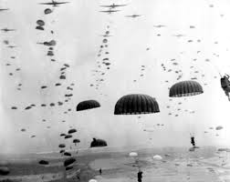
WWI and WWII
WWII
German Luftwaffe developed air supremacy
Kurt Student developed the parachuting strike force
Troops, equipment, weapons
Typically used “static line” parachute systems
Credited with being instrumental in turning the tide of the war

Slide 14
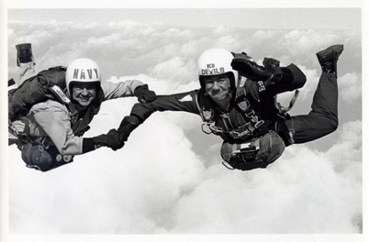
Post WWII
Lots of surplus parachutes
Ex-soldiers had the courage to jump them
Parachuting became a hobby
Competitions started post WWII
Skydivers emerge
Term coined by Raymond Young in the mid-1950s
1957 First commercial parachuting schools began to open

Slide 15
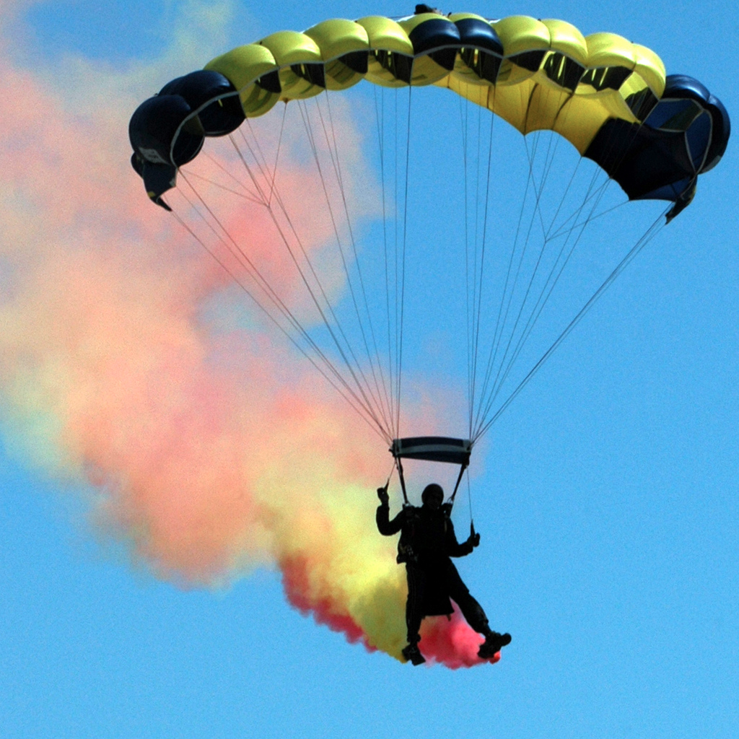
Modern Parachuting
Different parachutes
Synthetic materials
Stronger, easier to maintain
Ram-air canopies
MUCH safer
Most skydives involve both freefall and a parachute ride
Usually jump between 10,000 and 15,000 feet
Deploy parachute around 3500 feet
1 minute of freefall and 5 minutes of parachute ride
First competitions in 1951

Slide 16
Modern Parachuting
Many disciplines
Relative work (RW)
Freeflying
Canopy relative work (CRW)
Accuracy
Swooping
B.A.S.E.
Wingsuiting
Tracking
People often cross disciplines

Slide 17
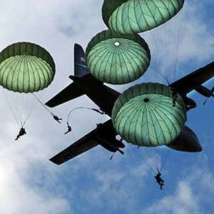
Changing Technologies
Traditional round canopies
1960’s saw a few changes
Cut slits in them for better stability
Relatively high malfunction rate
https://www.youtube.com/watch?v=glGvRv-CaZM
Parawings
1970’s
Single membrane wings
Designed for equipment and vehicles
NOT used for people (usually)

Slide 18
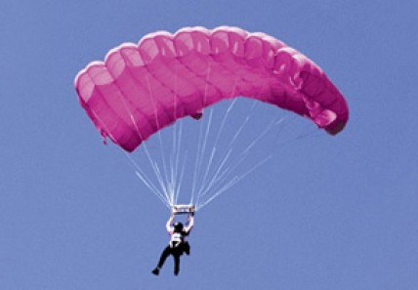
Changing Technologies
Ram-air parachute
Domina Jalbert, mid-1960’s
2 membrane airfoil design
Maintains shape by trapping air between the membranes
Only open at the nose
Provides a stable, inflatable, steerable parachute
Stabilizers provide side to side stability

Slide 19
https://www.youtube.com/watch?v=9aj9WPH10DM

Slide 20
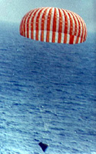
High Speeds and High Altitudes
Knacke and Madelung
Ribbon parachute system
Used for heavy, high speed payloads
Post WWII Knacke
Ring slot parachute system
Still used for subsonic cargo delivery and decelerating airplanes
Similar system used to decelerate spacecraft

Slide 21
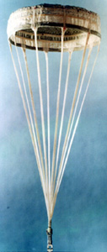
High Speeds and High Altitudes
H.G. Heinrich
Guide surface parachute
Used as a pilot chute or for vehicle stabilization
Tolerance of about Mach 3
Sims
Hyperflo parachute
Mach 1 – Mach 5 speed range

