Slide 1
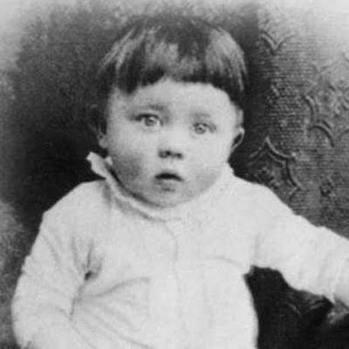
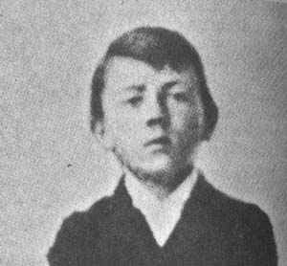
Growing Up Hitler
The Life of Adolf Hitler

Slide 2
Grandson of Jewish Grandfather?
Born in Braunau, Austria on April 20, 1889!
His father was born to an unmarried woman- who was rumored to be the maid of a Jewish homeowner.
-however Hitler’s grandfather has never been proven
Even Hitler himself had the Gestapo look into it in 1942 and nothing concrete came up

Slide 3
The Constant Failure
Dropped out at 16 years of age
Blamed his hatred for his father and his boring teachers for his failures
-pampered and spoiled by his mother
Suffered from frequent hallucinations
LAZY- never held a regular job until chancellor of Germany
-Refused to get a job when he father died, making his mother support him
Rejected from Vienna Academy of Fine Arts-blamed the stupid professors
Becomes homeless after his mother died- health conditions deteriorate so much that other bums don’t want his company- rejected from a shelter

Slide 4
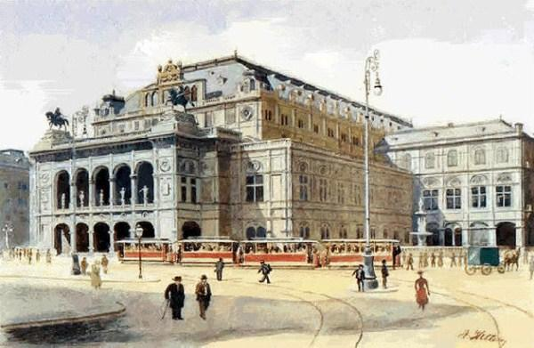

Slide 5
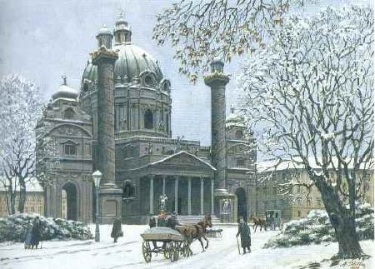

Slide 6
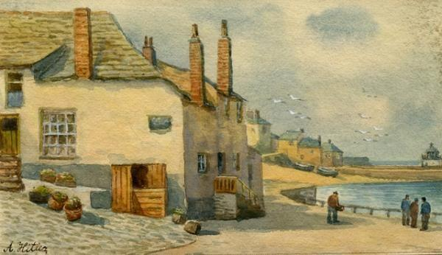

Slide 7
The Mind of Adolf- Vienna’s Impact
Europe and especially Austria-Hungary is a hot bed for social unrest.
Nationalism-a sense of pride in one’s nation and/or culture, think you are the best
Nationalism swept through Austria-Hungary but it did not unify the country- every ethnicity wanted to be its own nation
Austrian consider themselves German and wanted to break away and join the new nation of Germany
Eastern Europeans also wanted themselves to be independent

Slide 8
Radical German Nationalist and Racist
Nationalist arguments were taking place in Vienna
Felt Austria was “polluted with foreigners”
Felt nationalities had separate races of people- believed that some races were mentally and physically superior to others
Thought Eastern Europeans could never ruled themselves and that Jews were to be banished from Europe
Hated capitalism, communism, socialism and democracy- backed by Jews
Called any form of democracy that gave the “ignorant masses” the right to govern, pure nonsense

Slide 9
The Fanatical Jew-Hater
Grows from time in Vienna
George von Schonerer- wanted an all-German reich, or state, including Austria
Lanz von Liebenfels published anti-Semitic pamphlets that used swastikas as a symbol for the superiority of blond, blue-eyed Germans-Hitler always read
Hitler watched Karl Lueger, mayor of Vienna, get votes from being anti-Semitic

Slide 10
Experiences With Jews
Witness many Eastern European Jews move to Vienna and was upset at their traditional dress
Envied the lifestyle of the well-to-do Jews
Resented accepting free food from the Jews at the food kitchen
A Jew bought a cheap postcard of Hitler’s and he hated the pity in the eye of that Jew’s face.

Slide 11
Hitler’s Universal Scapegoat
Found out that one of the many admissions officers at the Vienna Art Academy were Jews, and vowed to make the Jews pay
Blamed not the cancer, but his mother’s Jewish doctor for her death
Blamed the Jews for all of the world’s problems

Slide 12
Draft Dodger
Moved to Munich to avoid being drafted into the Austrian army- which he said was “contaminated with Jews, Eastern Europeans, and other mongrels.”
Was caught by Austrian police but his wasted physical condition deemed him unfit for the Austrian military.
Sent back to Munich

Slide 13
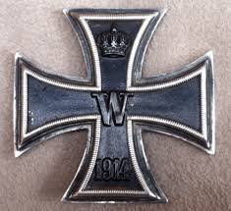
German Soldier
Was honored to serve in the German Army when World War I broke out in 1914.
Was a dispatch runner on the front line in France
Wounded twice and awarded four medals for bravery
Not promoted past corporal because he was a
loner and his hallucinations made him an oddball
Won the Iron Cross for his bravery.

Slide 14
German Messiah
Surviving dangerous missions made him feel like God had put him there to lead
Devastated by Germany’s lost- convinced the Jews were behind it
Hears voices to be savior-decided to go into politics uneducated, unskilled, penniless and without a friend

Slide 15
Hitler, The Spy
Germany’s new government under attack from communist so former soldiers are selected to spy- former soldiers don’t like new government either
Hated communists and was to find those soldiers that favored communism
Was to spy on political meetings of different groups in Munich

Slide 16
German Worker’s Party
Sept 12, 1919, sat in first German Worker’s Party meeting
Group wasn’t organized but was concerned with poor wages, working conditions and working classes
Hitler delivers wild speech and has a way with word- talks about the greatness of Germany and group wants him in the group- 7th member

