Slide 1
Leonardo Da Vinci
Mr. Jobb, 2015

Slide 2
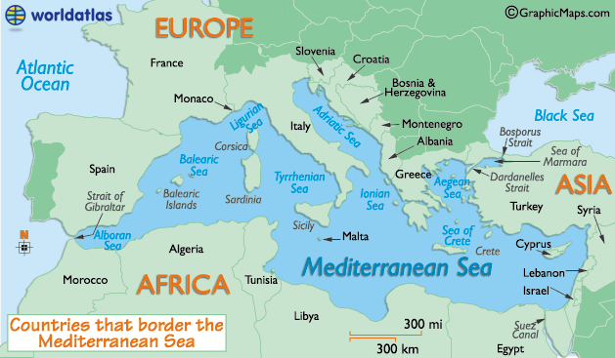
Italy in the Renaissance

Slide 3
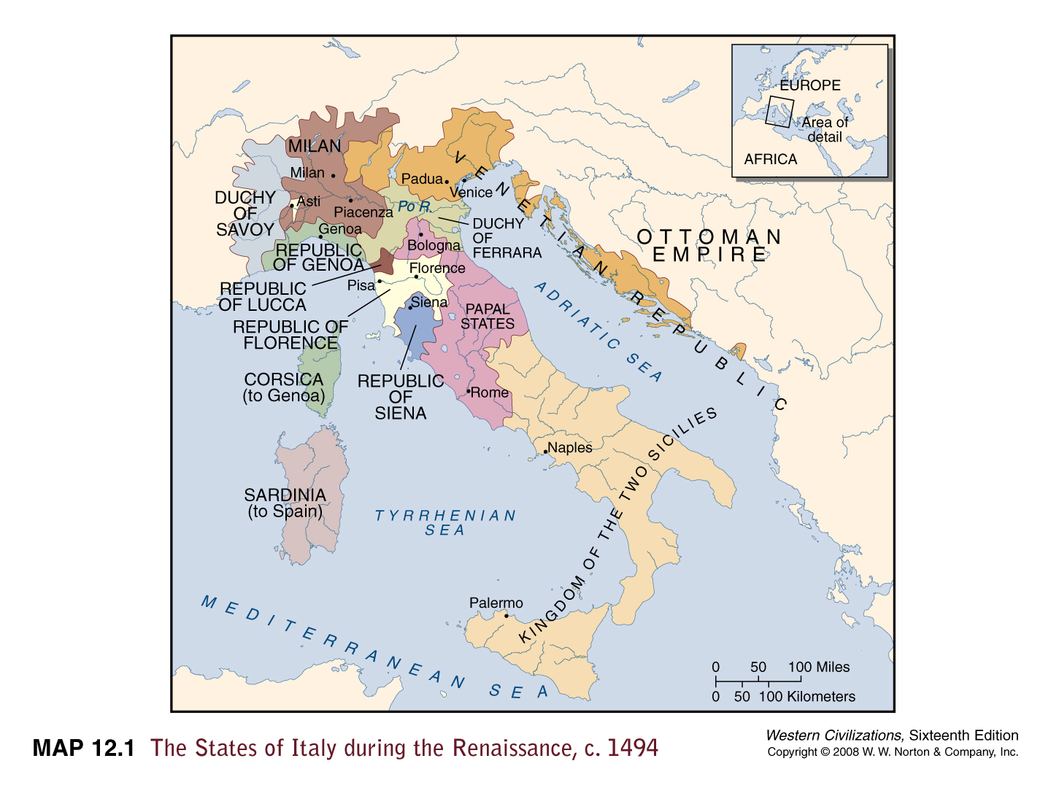
Italy in the Renaissance

Slide 4
Italy in the Renaissance

Slide 5
Background
Born April 15, 1452 in Vinci, Italy
Born out of wedlock
Raised by father, Piero da Vinci, and his stepmothers
Apprenticed to Verrocchio at age 14
Learned metalworking, leatherworking, carpentry, sculpting, painting, etc...
Master artist in the Guild of St. Luke by age 20
Had his own shop
Many patrons including Borgia and Medici families

Slide 6
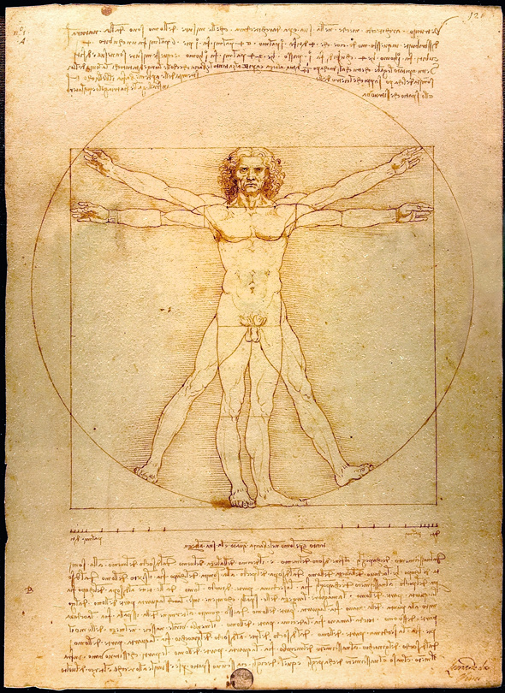
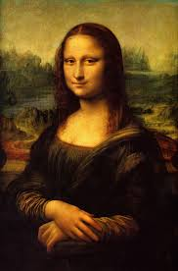
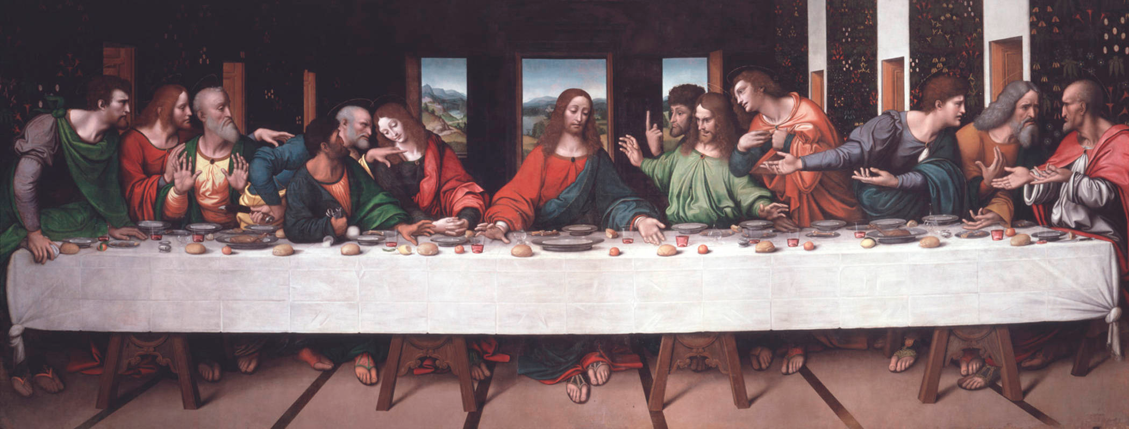
Leonardo the Artist
Famous Artist
Mona Lisa
Last Supper
Vitruvian Man

Slide 7
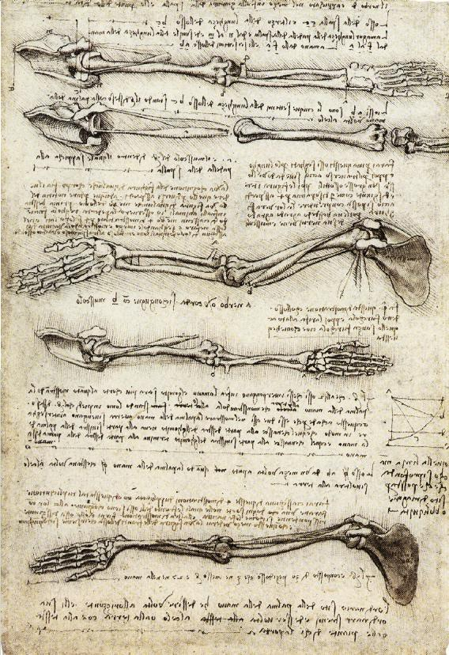
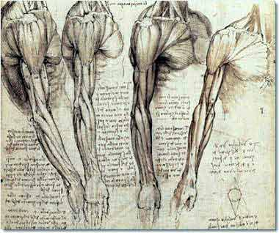
Leonardo the Anatomist
Studied human anatomy
Dissections
Drawings of systems
Muscles
Skeletons

Slide 8
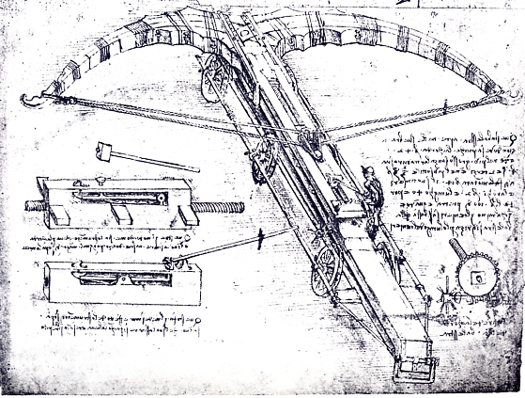
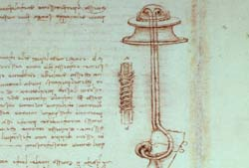
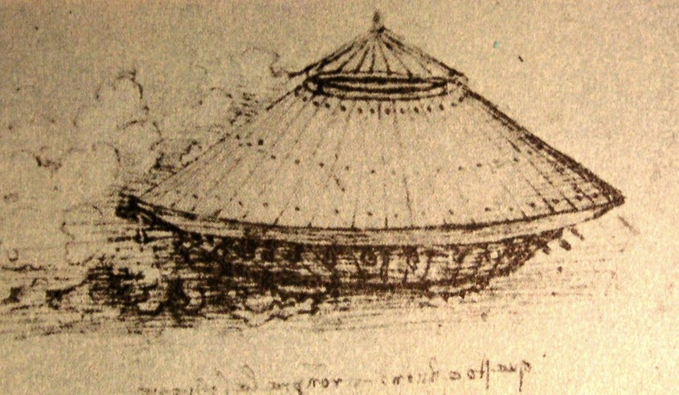
Leonardo the Inventor
Famous inventor
Diving suits
Tanks
Crossbows

Slide 9
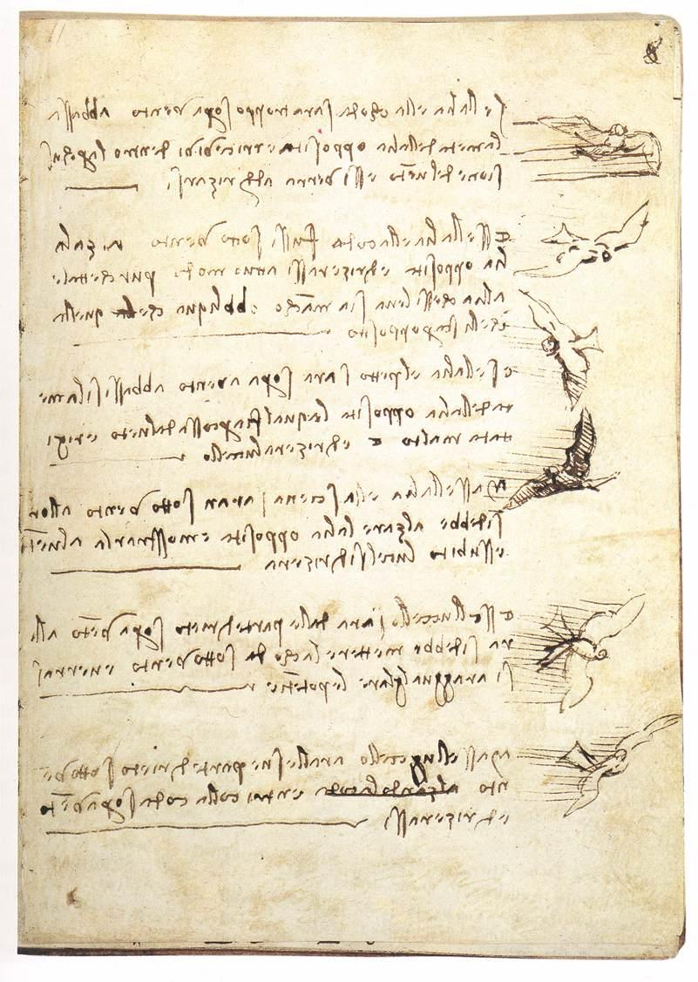
Leonardo the Aviator
Fascinated with the possibility of human flight
Devoted over 35,000 words and 500 images to it
Flying machines, nature of air, birds
Stemmed from work with military technologies
Ideal of aerial reconnaissance

Slide 10
Leonardo the Aviator
Drew on nature for his flying machines
Copy natural flight
Ornithopters
Machines that employ flapping wings to generate lift and propulsion
Work like a bird’s wings
Articulate the wings and get them to move
Limited muscle power and endurance of humans

Slide 11
Codex on the Flight of Birds
Serious study of the mechanics of flight
1505-6
Center of gravity and center of lifting pressure
Balance in flight
Explains behavior of birds ascending into the wind
Stall (Landing)
Curved wing section and lift
Analyzes the connection between weight, balance, and stability

Slide 12
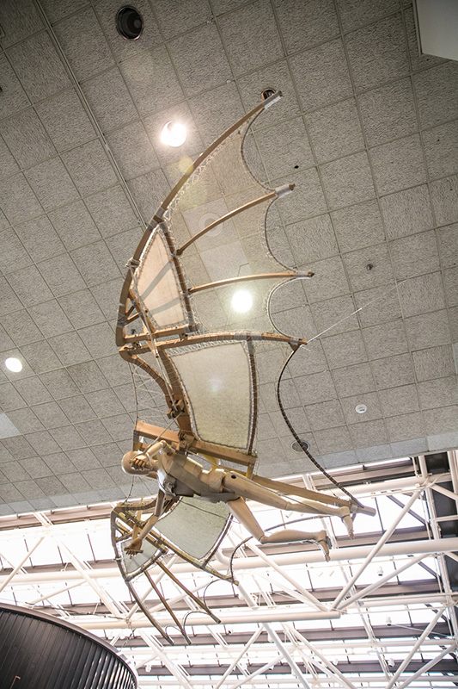
Codex on the Flight of Birds
Laid the groundwork for manned flight
Studies would be dawn on in a number of fields
Wright brothers used several of Da Vinci’s theories to build their first successful airplane

