Slide 1
African Geography
Mr. Jobb

Slide 2
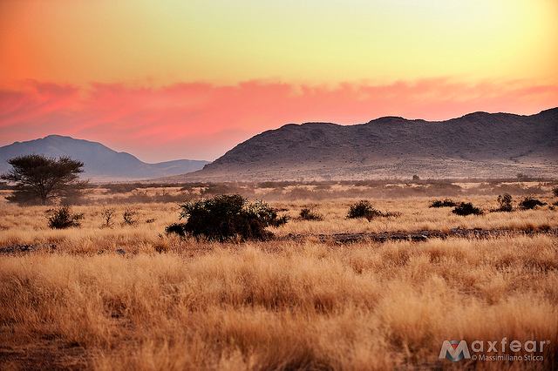
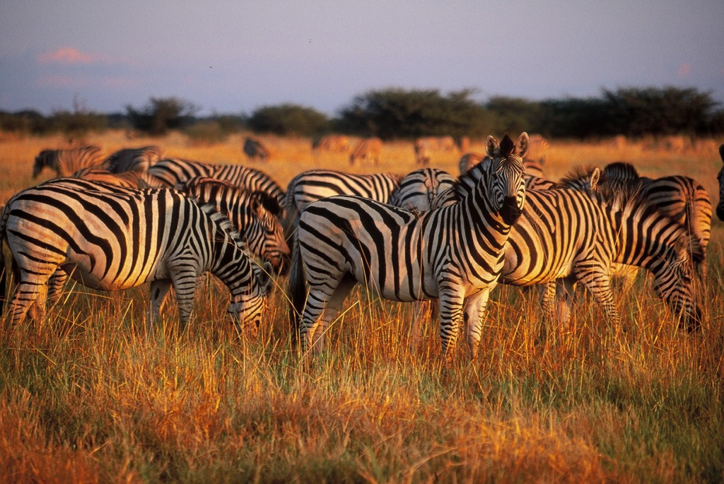
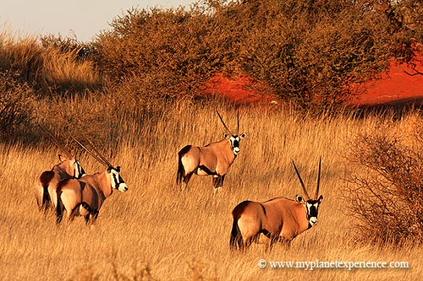
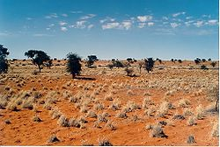
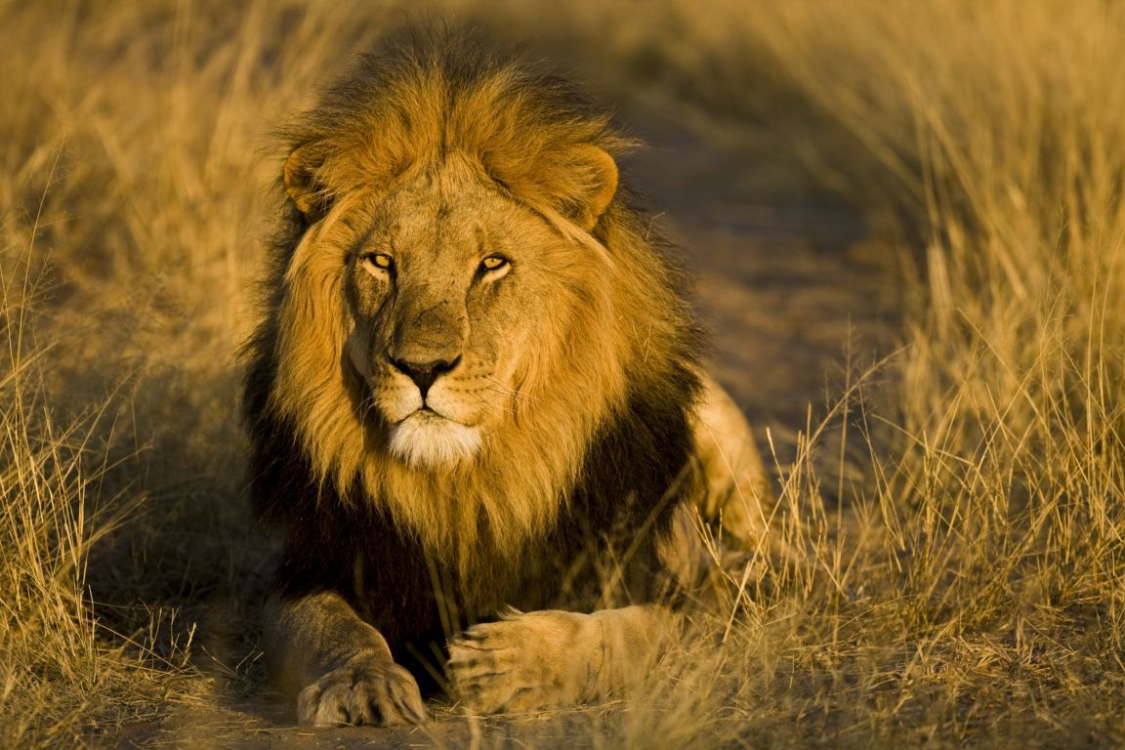
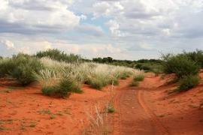
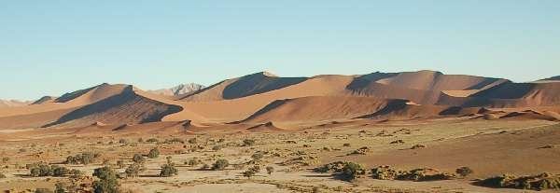

Slide 3
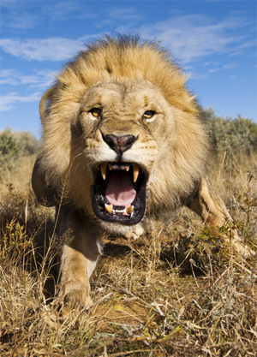
WRONG!

Slide 4
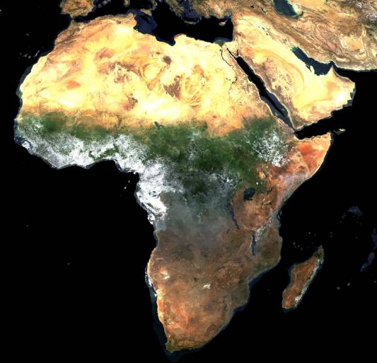
A Satellite View

Slide 5
Those pictures came from here!

Slide 6
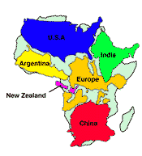
Africa’s Size
Second largest continent → 11,700,000 sq. mi.
10% of the world’s population.
2 ½ times the size of the U. S.
4 6 0 0 M I L E S
5 0 0 0
M I L E S

Slide 7
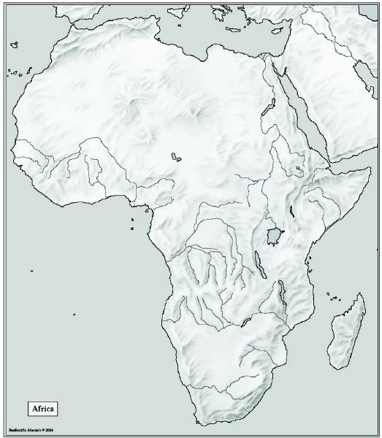
Bodies of Water
Mediterranean Sea
Red Sea
Nile River
Niger River
L. Chad-->
<--Gulf of Aden
L. Albert-->
Congo River
L. Victoria
L. Tanganyika->
Indian Ocean
Atlantic Ocean
Zambezi River
Limpopo River
Orange River
Pacific Ocean

Slide 8
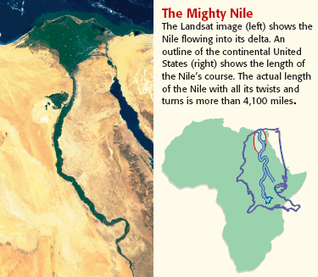
The Mighty Nile River: “Longest River in the World”

Slide 9
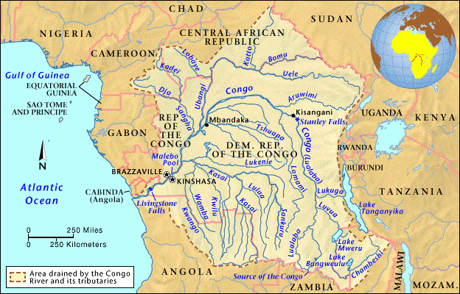
The Congo River Basin
Covers 12% of the continent.
Extends over 9 countries.
2,720 miles long.
Home to an entire network of rivers.

Slide 10
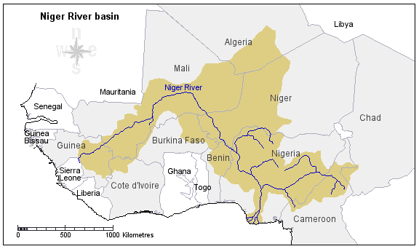
The Niger River Basin
Covers 7.5% of the continent.
Extends over 10 countries.
2,600 miles long.

Slide 11
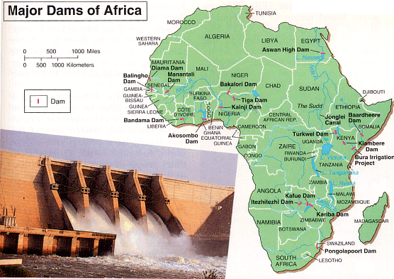
Hydroelectric Power

Slide 12
Mountains and Peaks
Atlas Mts.
Δ Mt. Kenya
Δ Mt. Kilimanjaro
Ruwenzori Mts.
Drajensburg Mts.

Slide 13
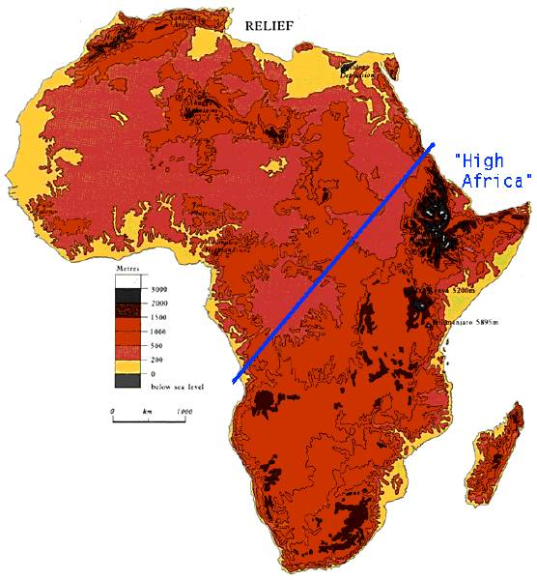
The African Plateau

Slide 14
Deserts
Libyan Desert
Sahara Desert
Sahel
Namib Desert
Kalahari Desert

Slide 15
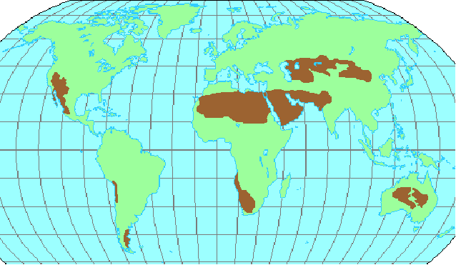
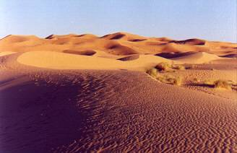
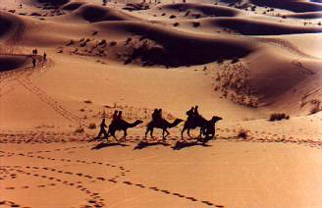
The Sahara Desert

Slide 16
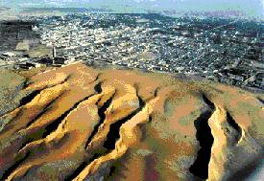
Desertification
Land becomes more arid
Loses Water
Loses Vegetation
Loses Wildlife
Poor Grazing Management
Poor Irrigation/Water Use Practices

Slide 17
The Great Rift Valley
Great Rift Valley

Slide 18
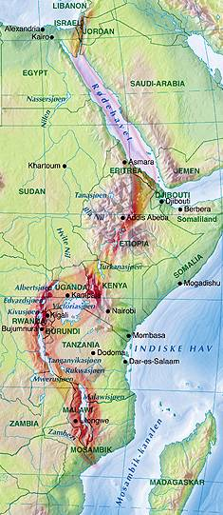
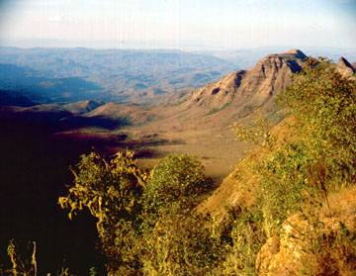
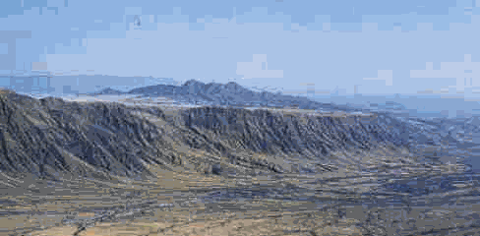
Great Rift Valley
3,000 miles long

Slide 19
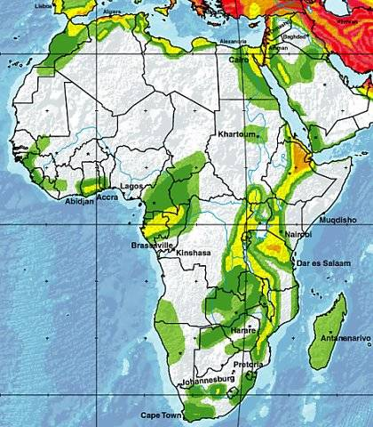
Seismic Activity in Africa

Slide 20
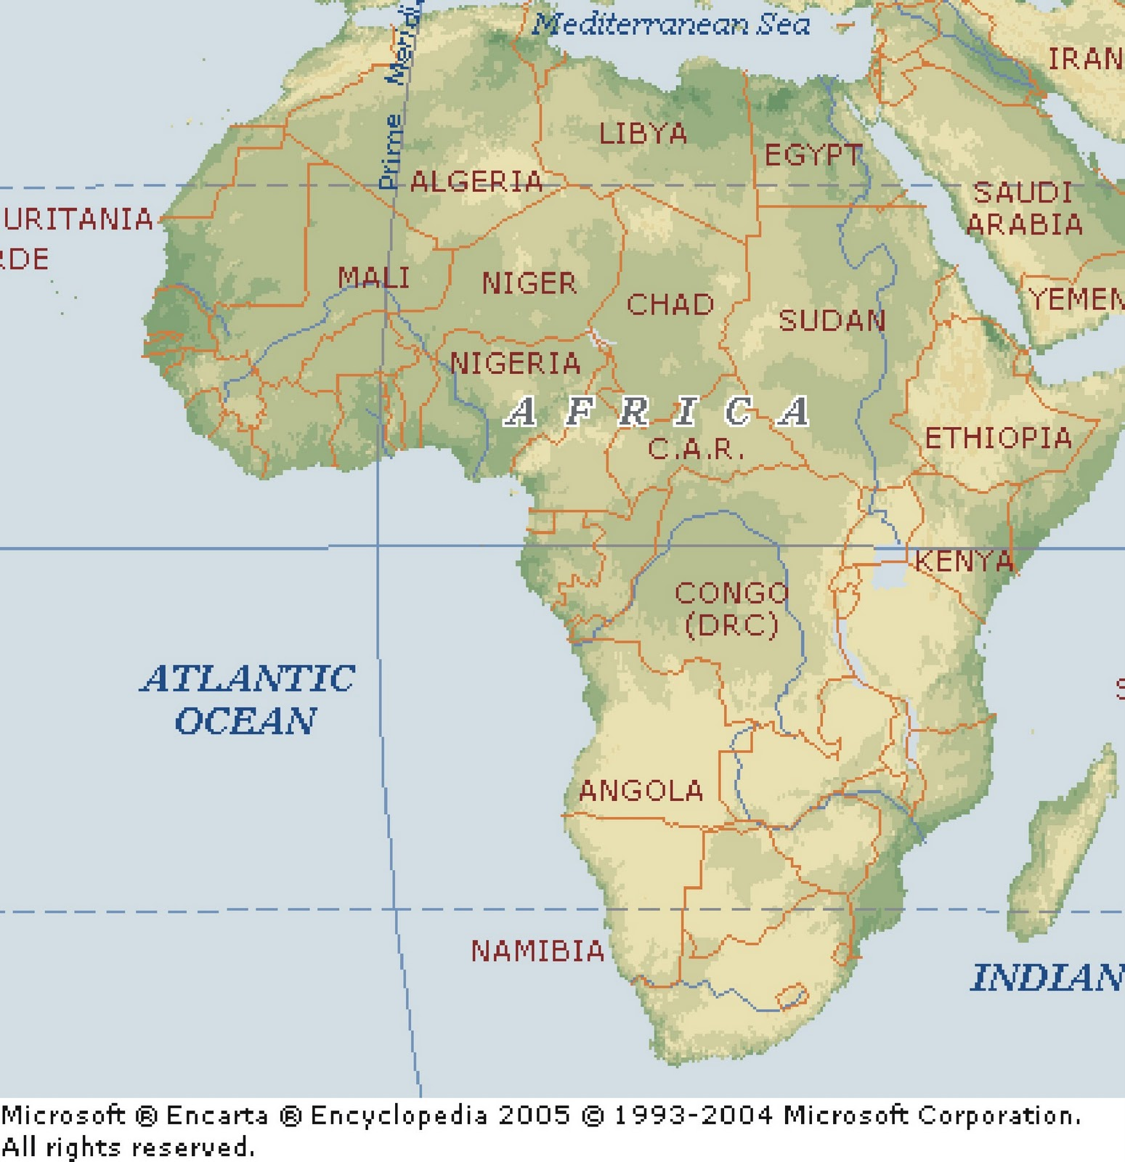
Africa – The Tropical Continent
Tropic of Cancer 23° 26’ N
Equator 0°
Tropic of Capricorn 23° 26’ S

Slide 21
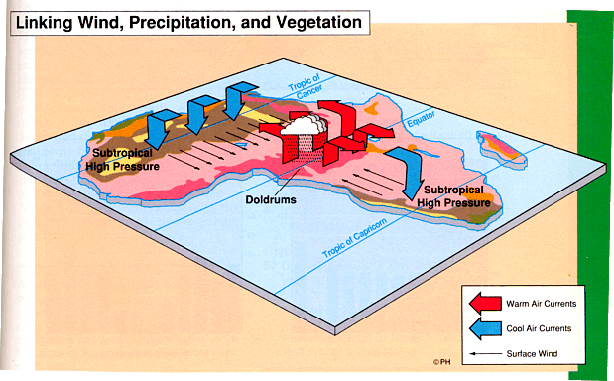
African Trade Winds

Slide 22
African Trade Winds

Slide 23
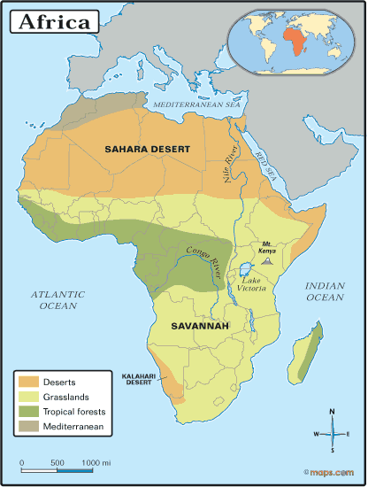
Vegetation Zones

Slide 24
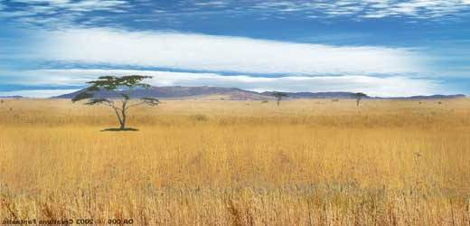
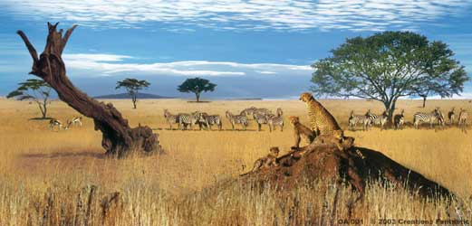
The African Savannah 13 Million Square Miles

Slide 25
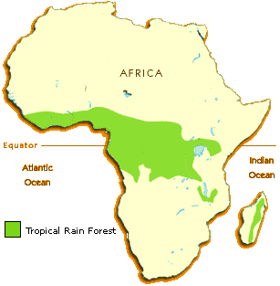
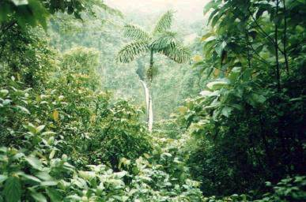
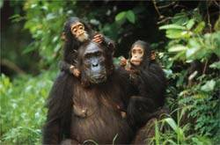
African Rainforest
Annual rainfall of up to 17 ft.
Rapid decomposition (very humid).
Covers 37 countries.
15% of the land surface of Africa.

Slide 26
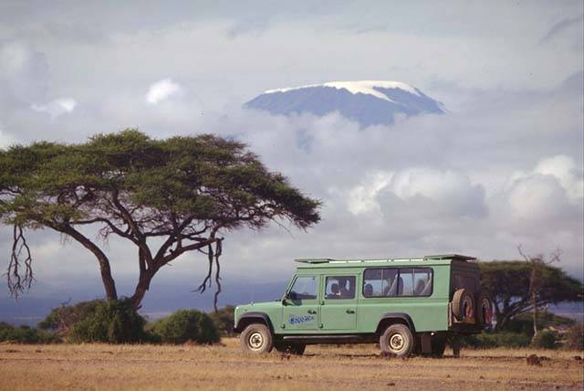
Mt. Kilimanjaro Snow on the Equator?

Slide 27
The Complete Topography of Africa
Atlas Mts.
Mediterranean Sea
Libyan Desert
Tropic of Cancer 23° 26’ N
Sahara Desert
Red Sea
Sahel
Nile River
Niger River
L. Chad-->
Great Rift Valley
<--Gulf of Aden
L. Albert-->
Equator 0°
Congo River
Δ Mt. Kenya
L. Victoria
Δ Mt. Kilimanjaro
L. Tanganyika->
Indian Ocean
Ruwenzori Mts.
Atlantic Ocean
Zambezi River
Namib Desert
Kalahari Desert
Tropic of Capricorn 23° 26’ S
Limpopo River
Orange River
Drajensburg Mts.
Pacific Ocean

Slide 28
END!

