Slide 1
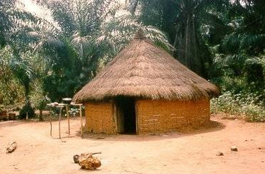
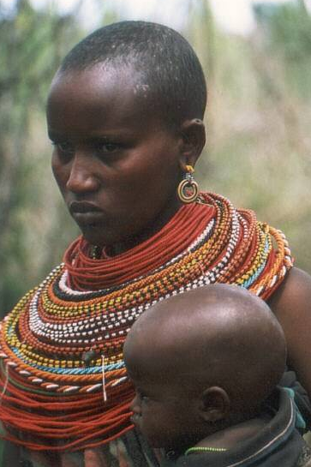
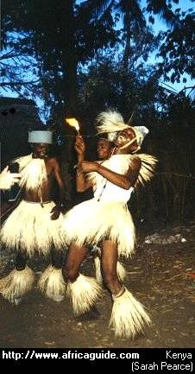
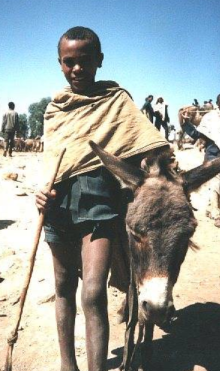
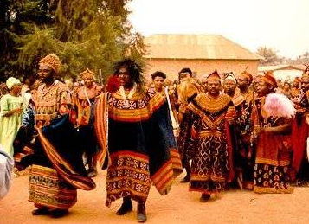
Traditional African Society
Mr. Jobb

Slide 2
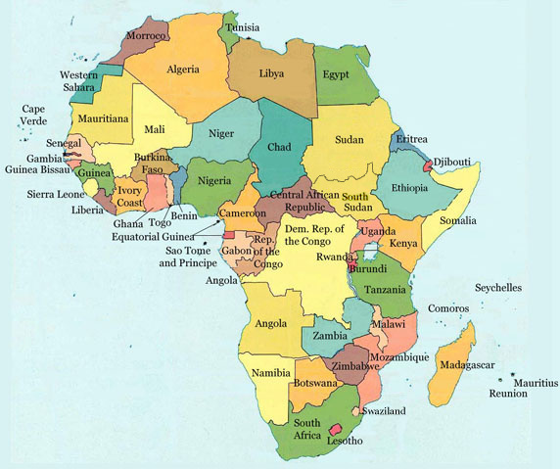
Disclaimer: Africa does NOT look like this

Slide 3
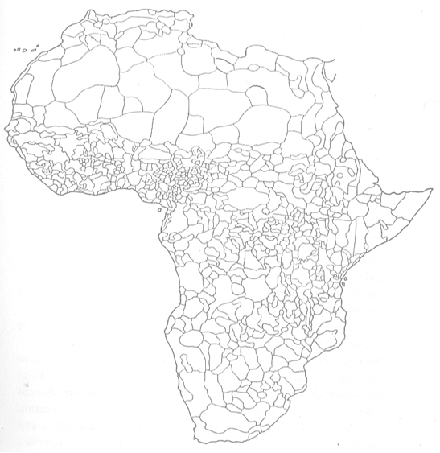
It looks more like this

Slide 4
Trade
Trade played a massive role in spreading culture.
Kush (iron, ivory, gold, ebony, slaves)
Ghana (iron, gold, ivory, ostrich feathers, hides, slaves)
Axum (ivory, frankincense, myrrh, slaves)
Egypt (metal goods, textiles, horses, salt)
Mali (gold, salt)
Songhai (gold, salt)

Slide 5
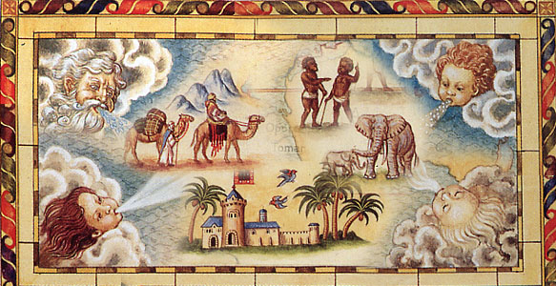
Trade Impacts
Rise of large cities
Timbuktu, Mogadishu, Mombasa, Kilwa, Meroe, Cairo, Mecca
Swahili Culture and Language
Combination of African and Arabian cultures

Slide 6
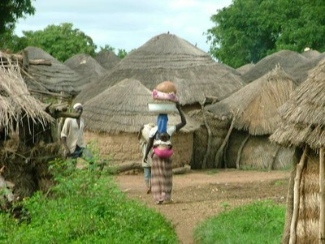
African Society
Stateless Societies
Southern Africa
Individual villages
Organized by Clans
Led by local ruler
Due to more trade larger cities and states started to develop.

Slide 7
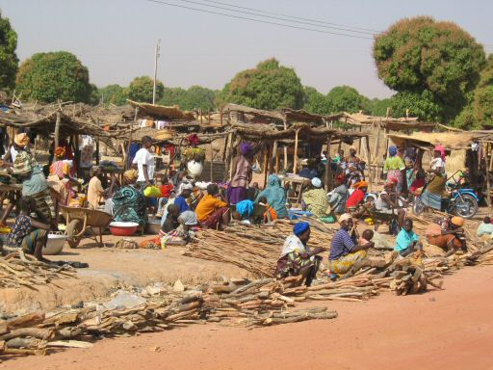
Origins
Walled villages
Center of governments
Marketplaces
TRADE GOODS!
Artisans
Metalworking, woodworking, pottery, art, crafts, jewelry

Slide 8
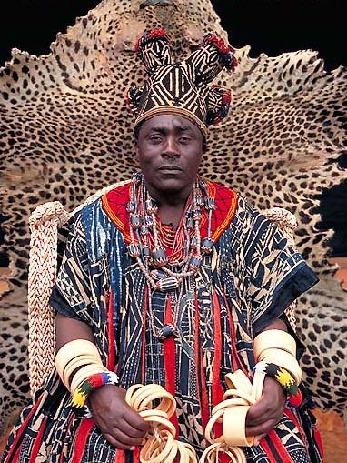
Kings and Subjects
Closer relationship with commoners than other places
Audiences to hear people’s problems
Still high above the general people
Protect trade
Merchants get favors, king gets taxes
Maintain law and order

Slide 9
Family and Lineage
Identity determined by extended family and lineage group
Extended family
Parents, grandparents, children
Live together in single mud hut
Lineage Group
Cornerstone of African society
Traced from real or legendary common ancestor
Elders held power
Support each other
Lineage from Mother, not Father

Slide 10
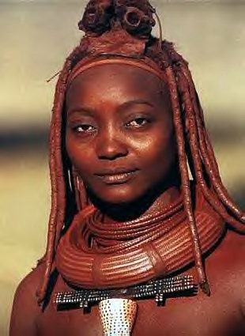
Role of Women
Subordinate to men
Work in field
Sometimes merchants
Could inherit property
Husband normally moved to wife’s house

Slide 11
Education
Children raised by mother until age 6
House of Men
Boys learn from fathers
Hunt, fish, grow plants, clear fields
House of Women
Girls learn from mothers
Care for home, work fields, become good wives and mothers, preparation for marriage

Slide 12
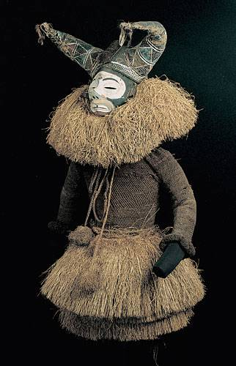
Coming of Age
Puberty = transition to full community member
Ritual where child symbolically dies and is reborn
It takes a village

Slide 13
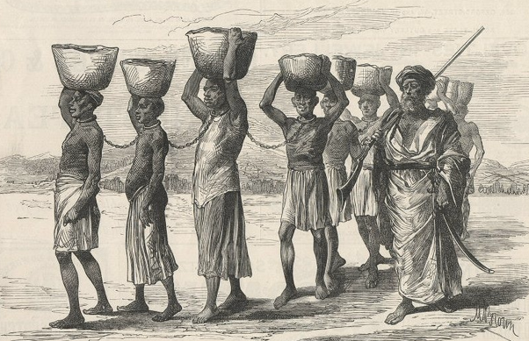
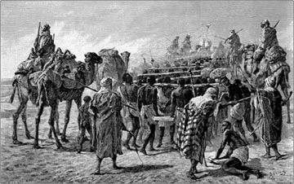
Slavery
Common throughout world
War captives, debtors, criminals
Berbers raided and traded
Life difficult
Farm slaves
Soldiers
Domestic servants
Could become trusted servants respected for knowledge/skills

Slide 14
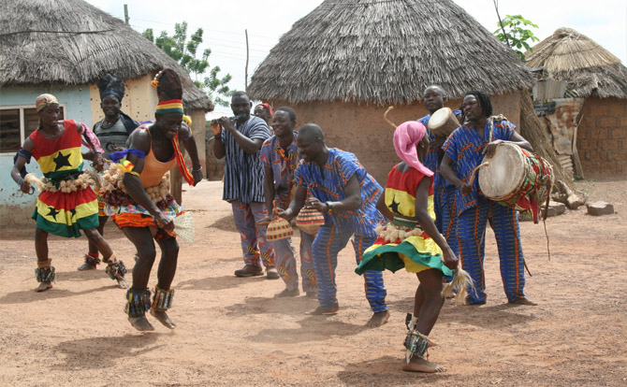
Religion
Animism
One supreme being
World of spirits (good and bad) in all things
Ancestor veneration
Rituals to worship
Belief in magic, charms, fetishes
Diviner – the mediator between God and tribe
Islam
25%
Christianity
20%

Slide 15
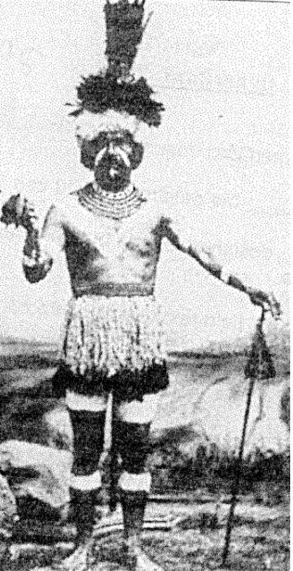
African Diviner (Shaman)

Slide 16
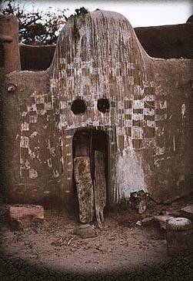
World of the Spirits
Dogon “Spirit House”

Slide 17
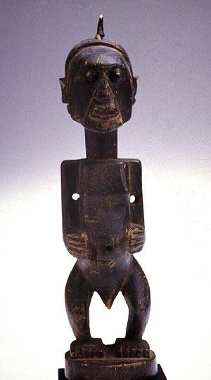
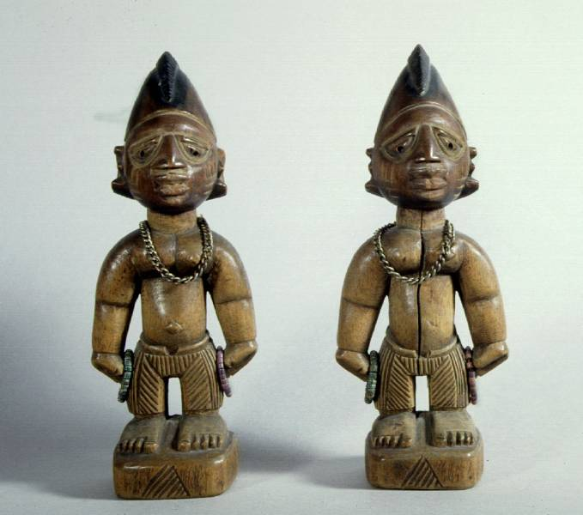
Ancestor Idols

Slide 18
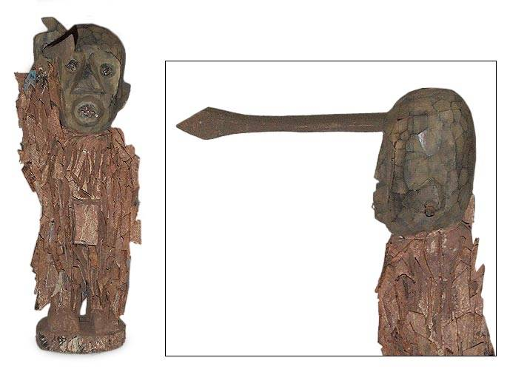
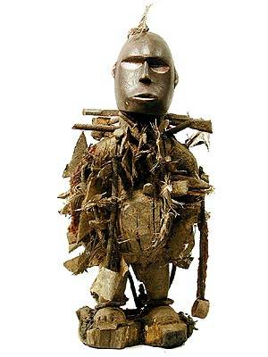
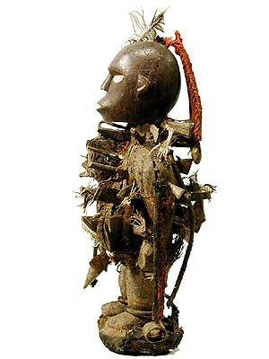
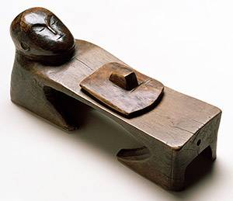
Fetishes

Slide 19
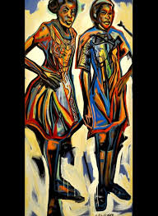
Art
Often tied to religion
Many types
Rock painting (scenes from life)
Wood carvings (masks, statues – gods, spirits, ancestors)
Believed to embody the spirits

Slide 20
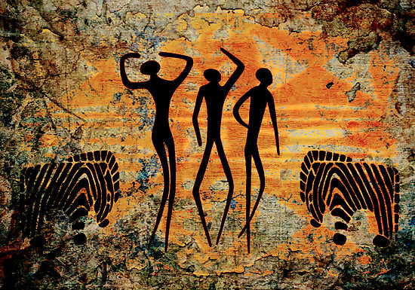
Art Cont…
Music and dance
Religious and ritual purposes
Heavily influenced Western music
Social purpose
Pass on history and traditions
Storytelling
Jewelry
Tell story, social symbol, cultural affiliation, rituals, weddings, money
Uganda

Slide 21
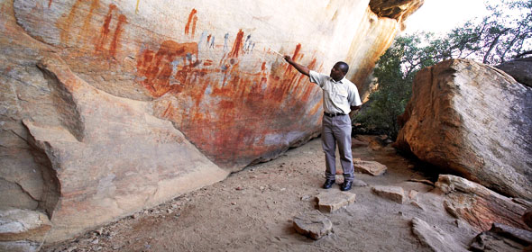
Rock Paintings

Slide 22
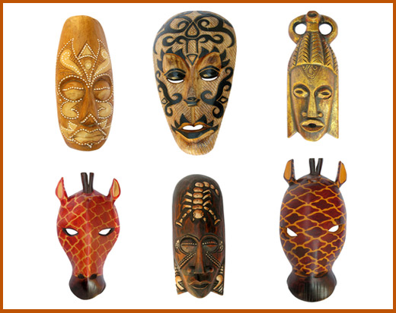
Masks

Slide 23
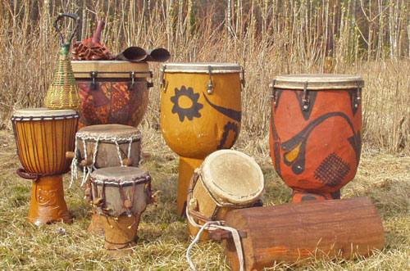
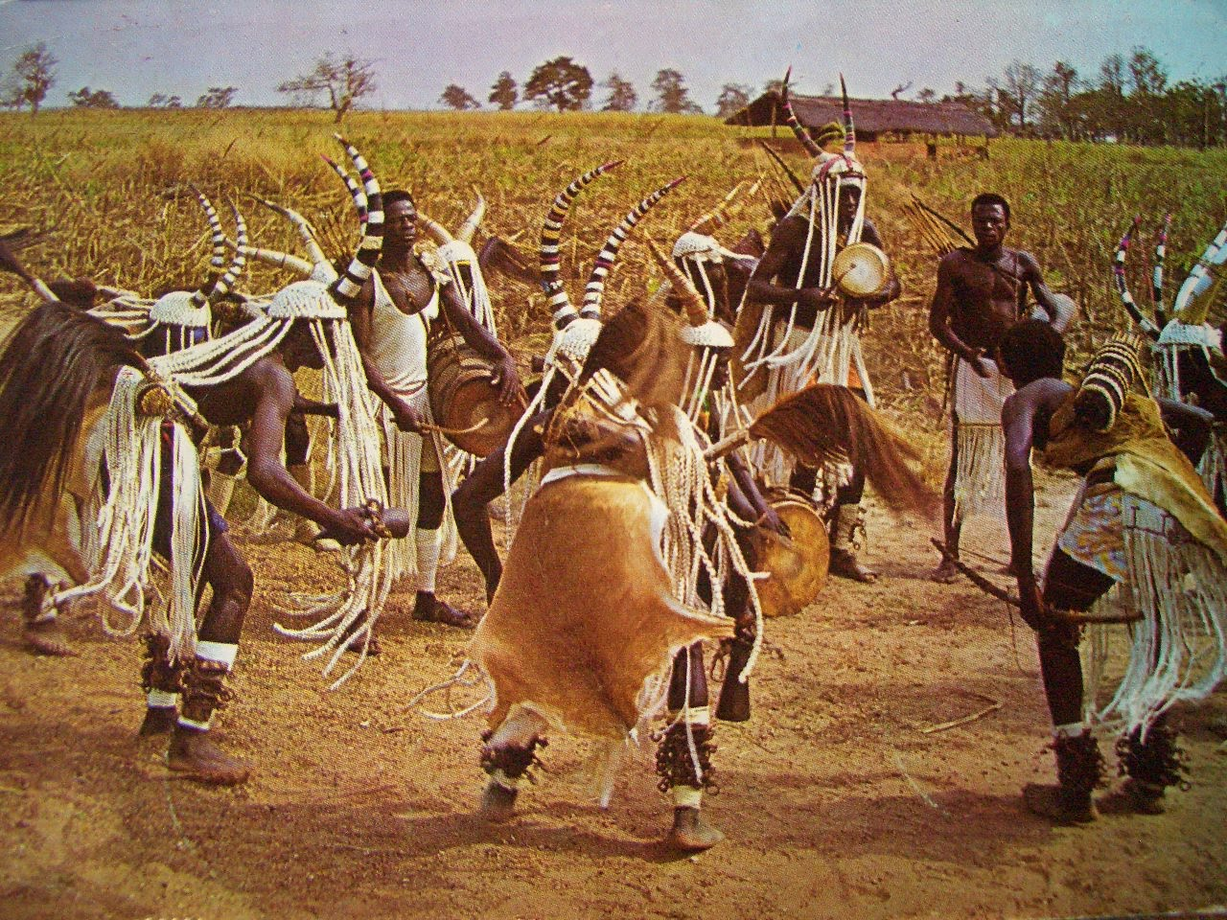
Music and Dance

Slide 24
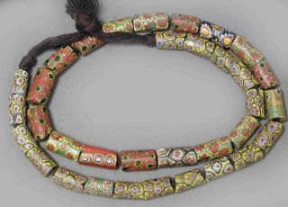
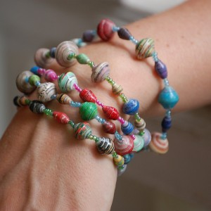
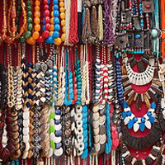
Jewelry

